Slide 1
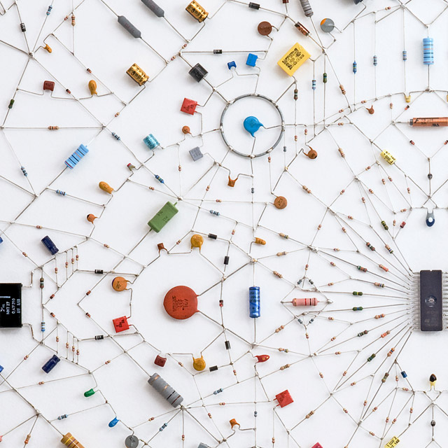
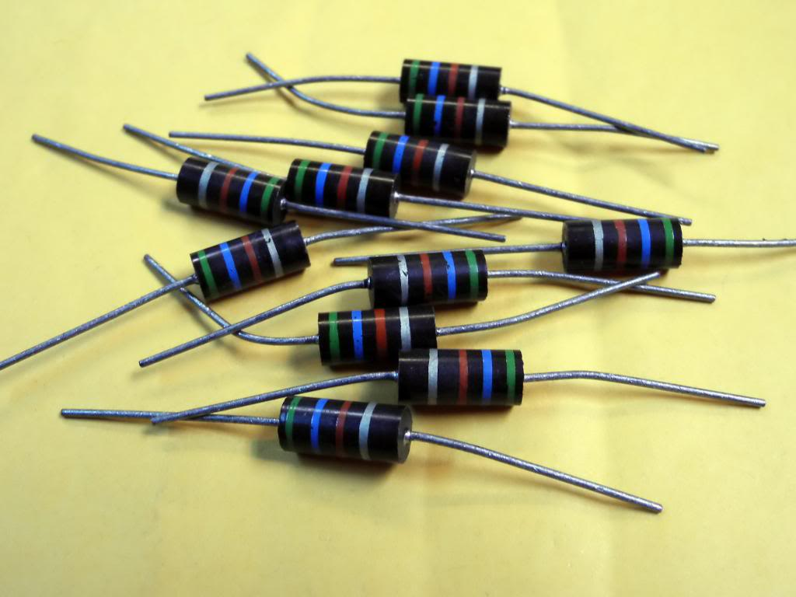
CH 11: Electricity and Its Production
11.7 – Electrical Resistance
11.8 – Resistors in Circuits

Slide 7
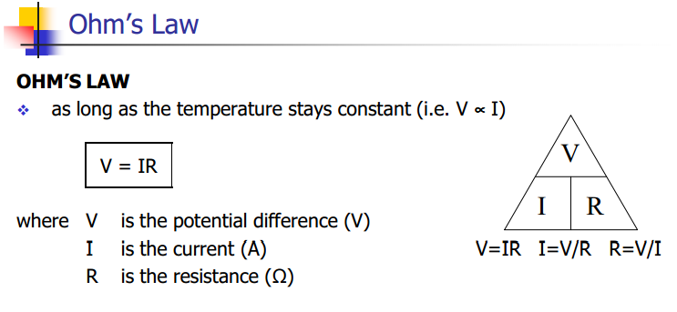

Slide 8
Practice #1 pg.525

Slide 9
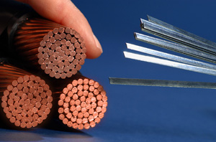
Superconductors
http://www.youtube.com/watch?v=a9GqGO8wp04

Slide 10
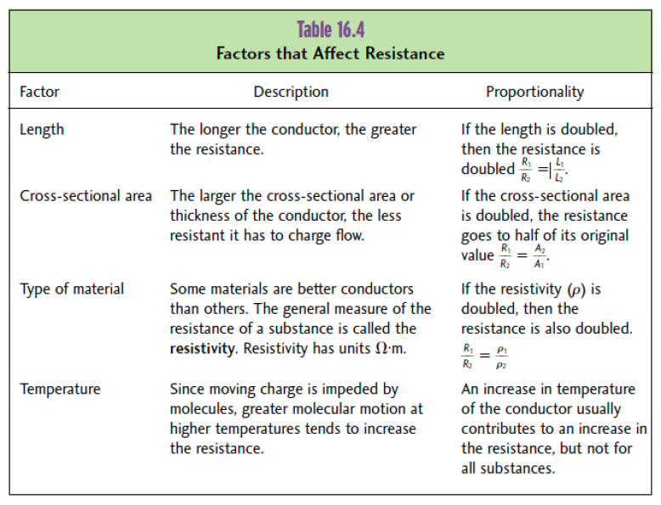

Slide 14
Practice #2 pg. 527

Slide 17
Practice #2 pg. 529

Slide 20
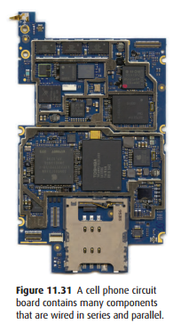

Slide 21
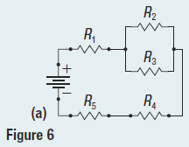
Practice #1a pg. 530

Slide 22
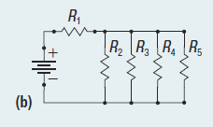
Practice #1b pg. 530

Slide 23
Classwork & Homework

