Slide 1
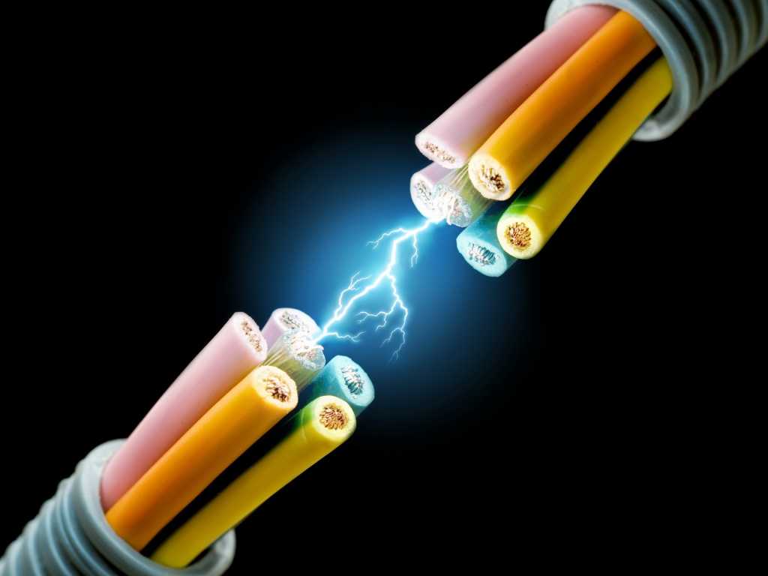
CH 11: Electricity and Its Production
11.6 – Kirchhoff’s Laws

Slide 2
Agenda
Review
Section 11.6
Homework problems

Slide 3
Law of Electrical Charges
Like charges repel one another and unlike charges attract one another
Neutral objects have no effect on one another and are attracted to both positively and negatively charged particles
Charged objects attract some neutral objects

Slide 4
What is a charge?
Objects that exert electric forces are said to have a charge.
A charge is the source of electrical forces
Two kind of charges – positive and negative

Slide 5
Electric charge
The smallest unit of electric charge (e) is the charge on a single electron
The elementary charge (e) has a magnitude of 1.60 x 10⁻¹⁹ C
it would take 6.24 x 10¹⁸ electrons to make up 1C of charge
Thus 1 C of charge = 6.24 x 10¹⁸ e

Slide 6
Electric charge
The formula to measure the total charge (Q) on an object which is measured in coulombs is given by the equation
Q = Ne
Where Q is the total charge measured in C
N is the excess or deficit of electrons
e is the charge (elementary charge)

Slide 7
Electricity and electric circuits
Electric current: the movement, or flow of electric charges from one place to another
Electric circuit: the controlled path taken by an electric current

Slide 8
Electric current
The symbol for current is I and the unit is A (amp)
Current is defined as the charge that goes by a given point in a given amount of time
I = Q / t
Where I is the current
Q is the charge and t is for time

Slide 10
The direction of electric current
Conventional current or electric current – is the movement of the electric current from the positive terminal to the negative terminal of the source of the electric potential – this is not correct

Slide 11
Direction of flow
Electric current is the flow of negatively charged electrons that moved from the negative terminal to the positive terminal of the source of electric potential
This is referred to as electron flow

Slide 12
Electric Potential Difference - Voltage
The amount of work required per unit charge to move a charge from one point to another is known as electric potential difference
V = W / Q
V = potential difference measured in volts (V)
W = work or change in energy measured in joules (J)
Q = total charge measured in coulombs (C)
Unit analysis : 1J / C = 1 volt

Slide 13
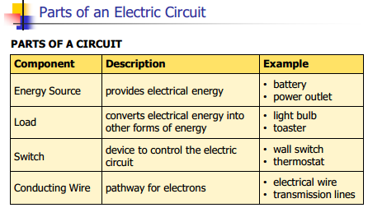
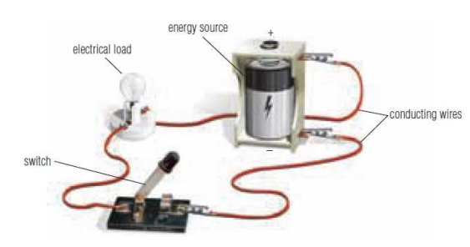

Slide 14
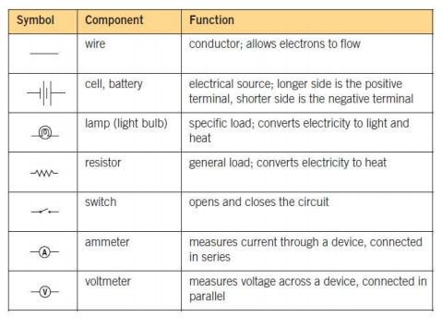

Slide 23
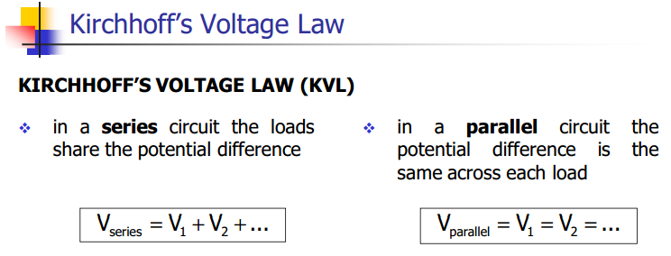

Slide 24
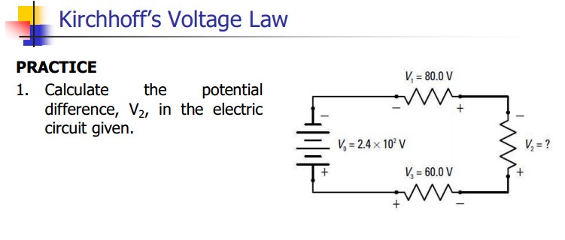
Notes:
V2 = 100 V

Slide 28
Notes:
I3 = 6.0 A

Slide 32
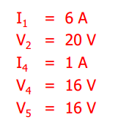
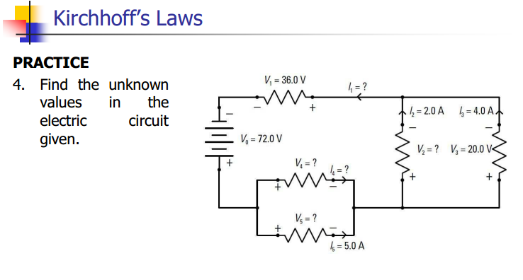

Slide 34
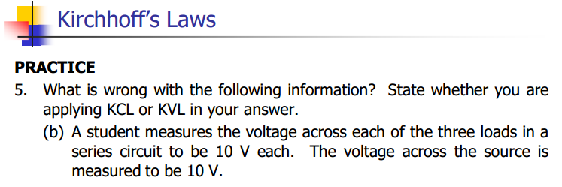

Slide 35
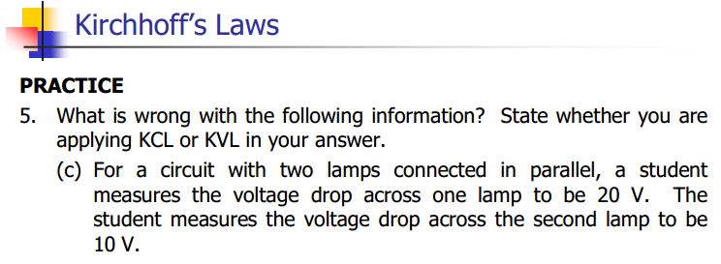

Slide 36
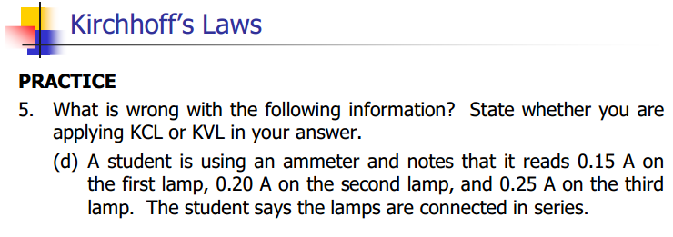

Slide 37
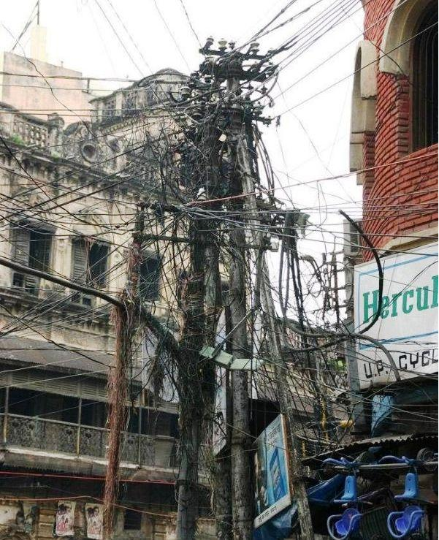
Kirchhoff’s Law: NOT APPLICABLE IN INDIA

Slide 38
Classwork & Homework
Pg. 522 #1 and 2

