Slide 1
CH 10: Applications of Waves
10.1 – Human Hearing
10.5 – Seismic Waves
10.7 – Nature and Sound Waves

Slide 2
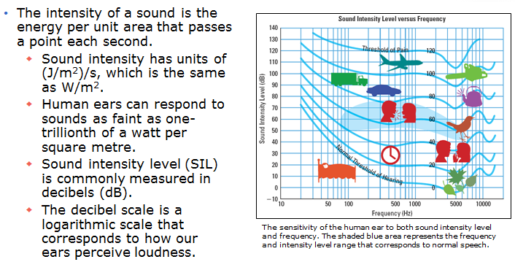
Intensity and the Decibel Scale

Slide 3
DesignmateEureka
http://www.youtube.com/watch?v=GkNJvZINSEY

Slide 4
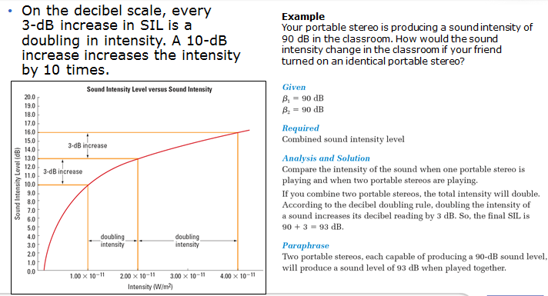
Intensity and the Decibel Scale

Slide 5
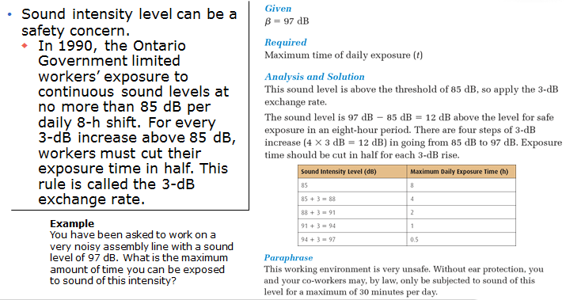
Noise, Music, and Hearing Loss

Slide 6
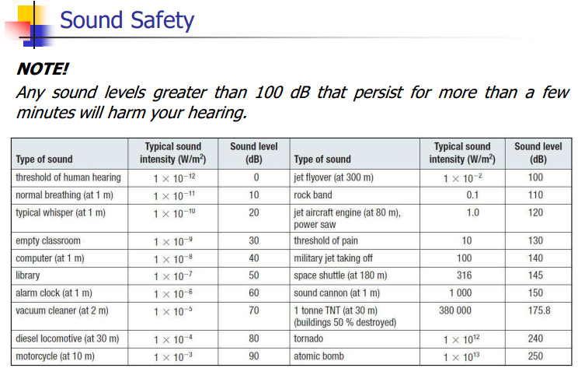

Slide 7
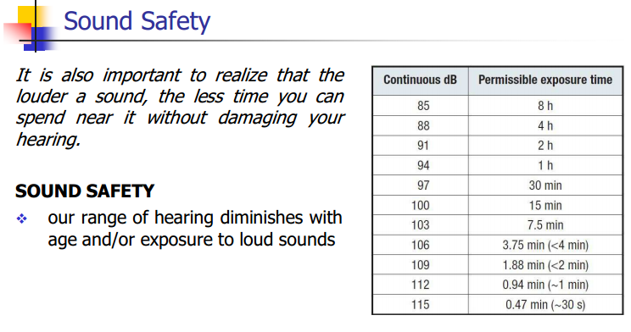

Slide 8
Hearing Loss
http://www.phonak.com/com/b2c/en/hearing/understanding_hearingloss/how_hearing_loss_sounds.html
Can you hear this?
http://www.noiseaddicts.com/2009/03/can-you-hear-this-hearing-test/

Slide 10
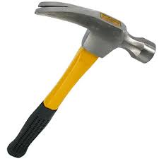
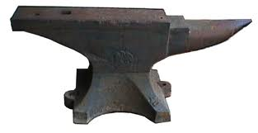
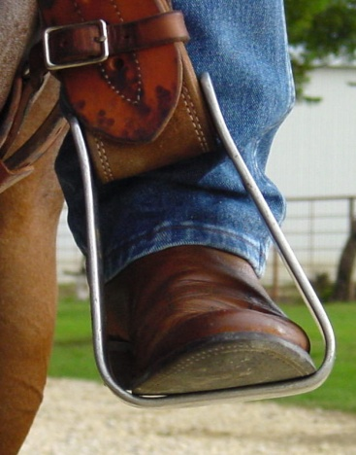
Hammer, Anvil, & Stirrup

Slide 13
http://www.youtube.com/watch?v=r-c5GpoD8wI

Slide 14
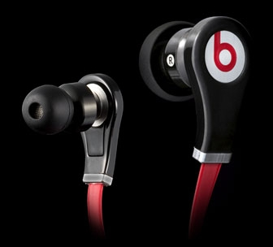

Slide 22
Earthquakes
http://www.youtube.com/watch?v=PwtFuG_M4EE

Slide 24
http://www.youtube.com/watch?v=r9mvRRwu5Gw

Slide 35
Classwork & Homework

