Slide 1
4.1 – Systems in Plants

Slide 11
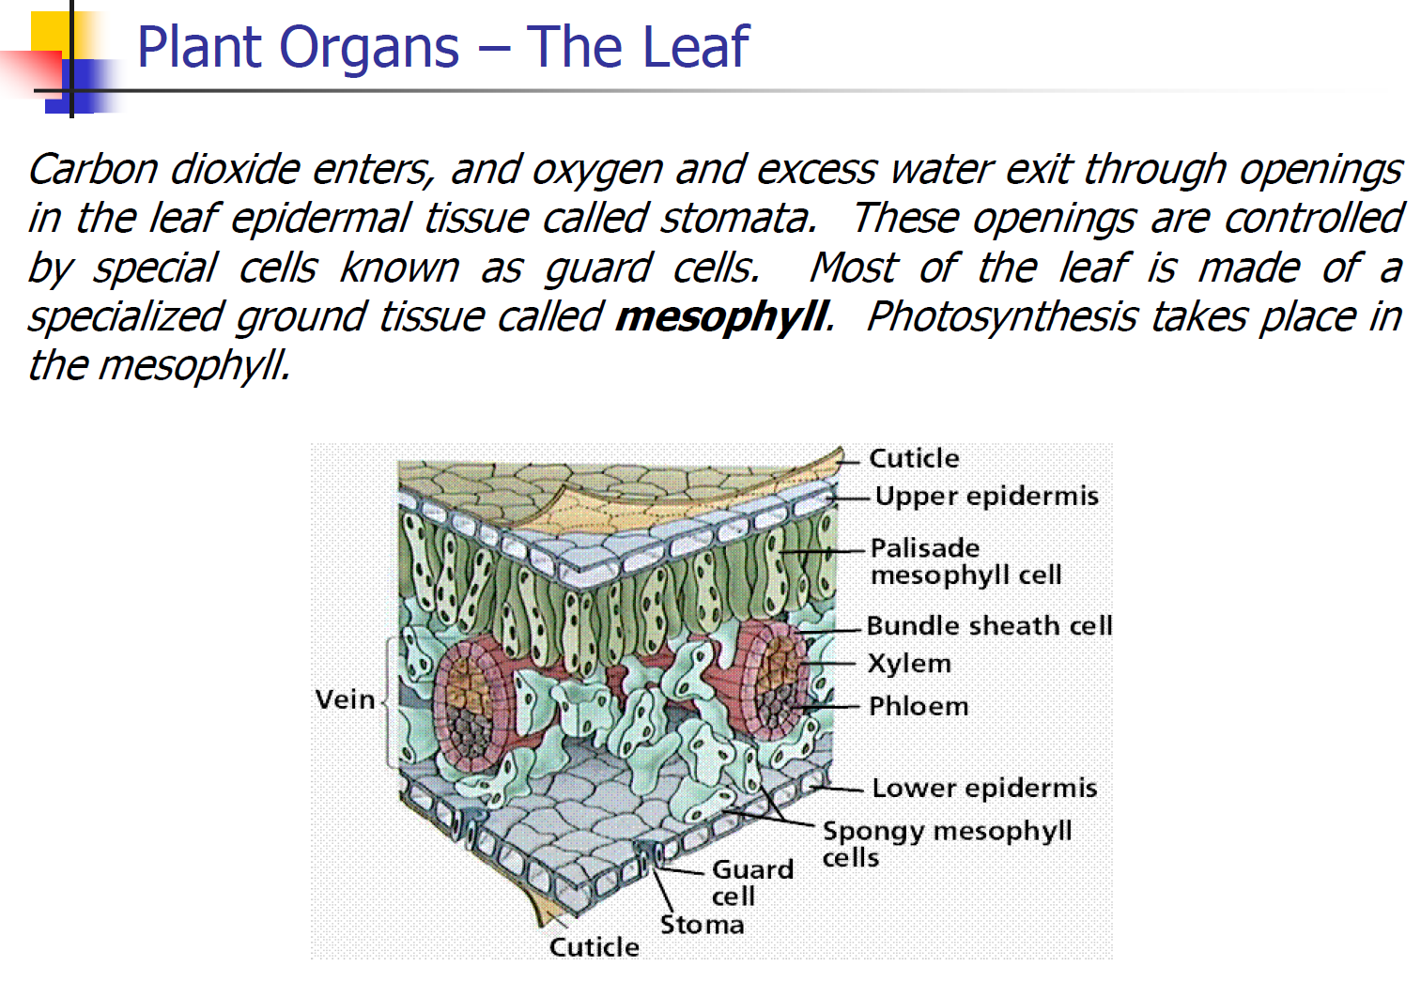

Slide 14
