Slide 1
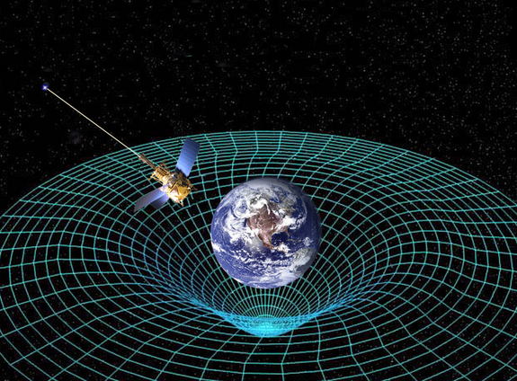
Ch12: Quantum Mechanics
12.2 – Photons and the Quantum Theory of Light
(pg. 620-623)

Slide 36
Classwork & Homework

