Slide 1
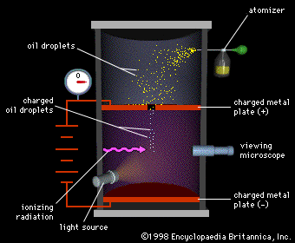
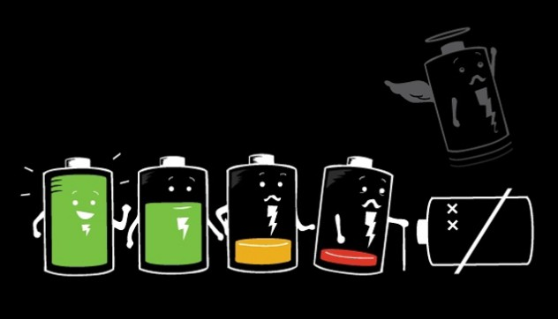
Ch7: Electric Fields
7.4 – Potential Difference and Electric Potential (pg. 346-349)

Slide 17
Classwork & Homework

