Slide 1
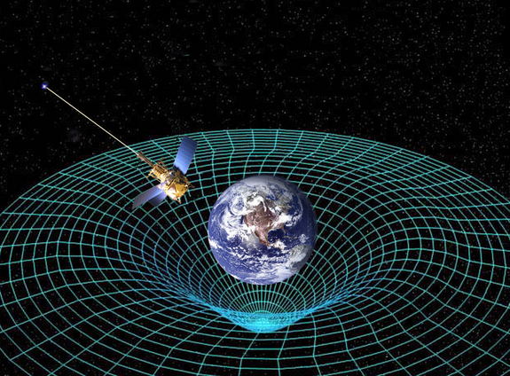
Ch12: Quantum Mechanics
12.1 – Introducing Quantum Mechanics
(pg. 616-619)

Slide 8
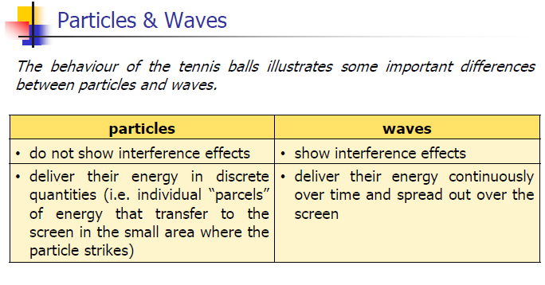

Slide 20
Classwork & Homework

