Slide 1
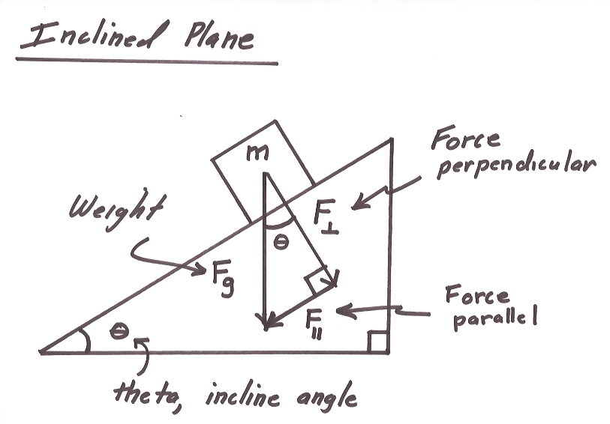
Ch2: Dynamics
2.3 – Applying Newton’s Laws of Motion (pg. 77-83)

Slide 26
Classwork & Homework

