Slide 1
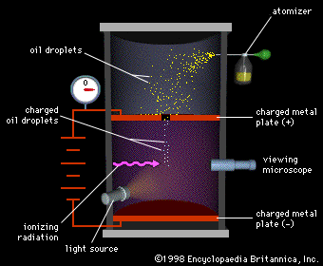
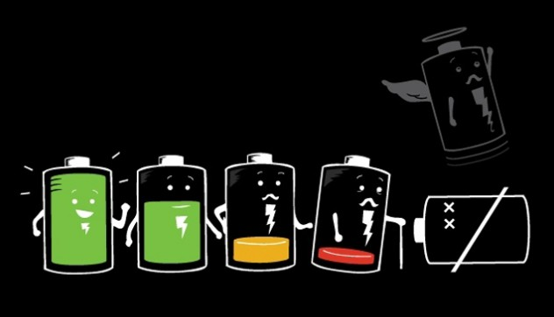
Ch7: Electric Fields
7.2 – Coulombs Law (pg. 329-333)

Slide 6
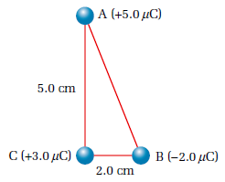

Slide 7
Classwork & Homework

