Slide 1
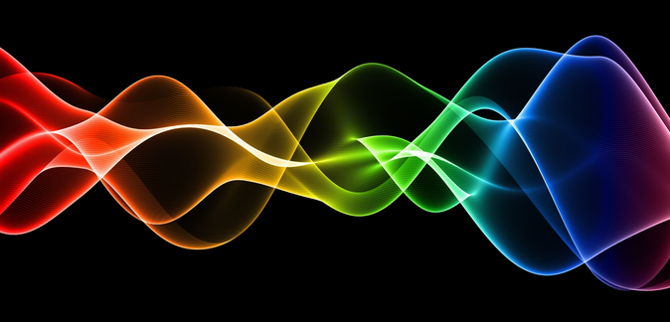
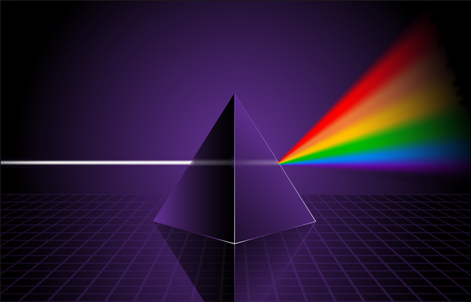
Ch9: Waves and Light
9.4 – Light: Wave or Particle? (pg. 470-476)

Slide 17
Classwork & Homework

