Slide 1
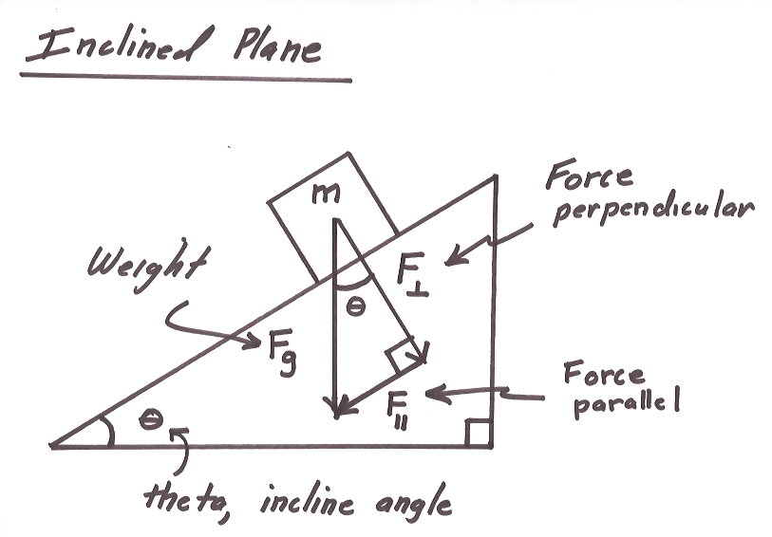
Ch2: Dynamics
2.1 – Forces & Free-Body Diagrams (pg. 62-69)
2.2- Newton’s Laws of Motion (pg. 70-76)

Slide 2
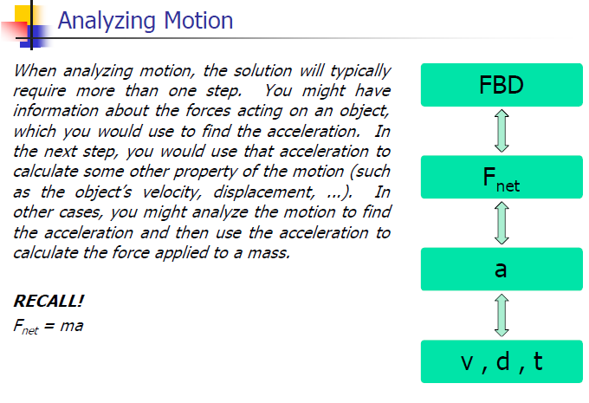

Slide 21
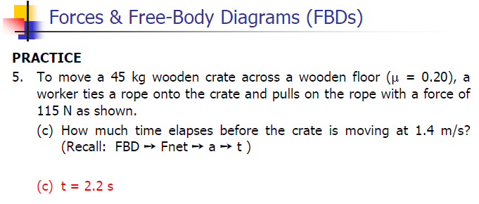

Slide 31
Newton’s 3 Laws with a bicycle – Ted-Ed
https://www.youtube.com/watch?v=JGO_zDWmkvk

Slide 32
Classwork & Homework

