Slide 1
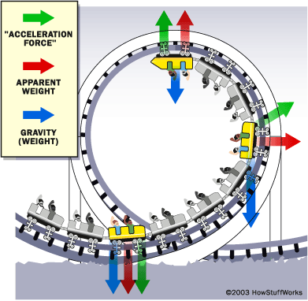
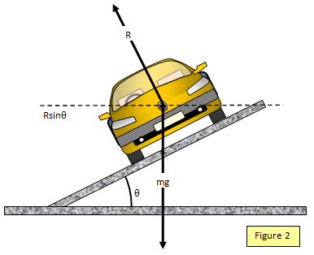
Ch3: Uniform Circular Motion
3.4 – Rotating Frames of Reference
(pg. 125-130)

Slide 4
Rotating Frame of Reference
http://www.youtube.com/watch?v=dt_XJp77-mk
Coriolis Effect – deflection of moving objects when they are viewed in a rotating frame of reference

Slide 6
Centrifugal Force Demo
http://www.youtube.com/watch?v=-LDxOSz80pI

Slide 9
Centripetal vs. Centrifugal Force
https://youtu.be/9s1IRJbL2Co

Slide 10
Classwork & Homework

