Slide 1
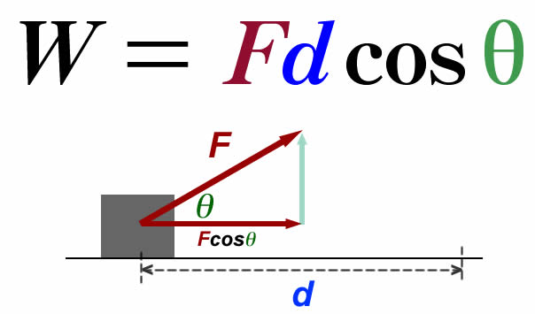
Ch4: Work & Energy
4.3 – Gravitational Potential Energy (pg. 177-181)

Slide 3
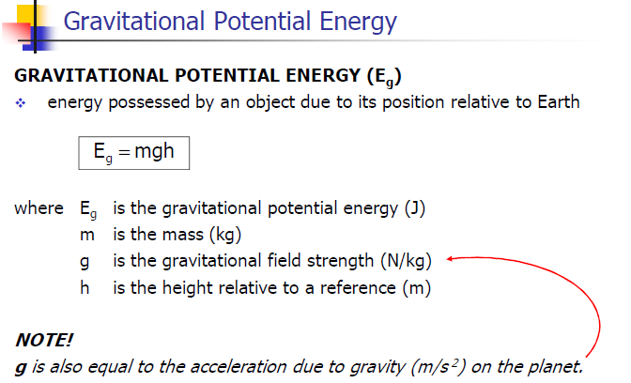

Slide 8
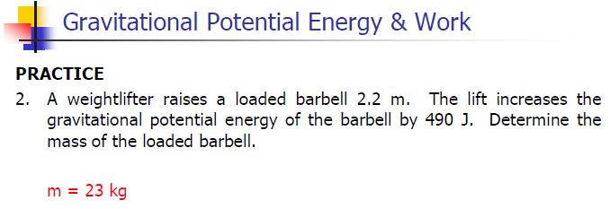

Slide 10
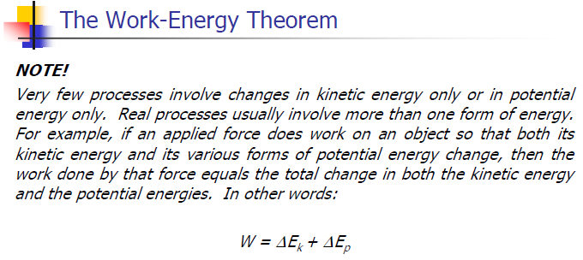

Slide 11
Classwork & Homework

