Slide 1
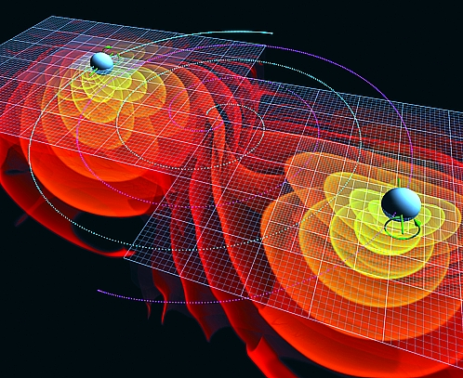
Ch6: Gravitational Fields
6.1 – Newtonian Gravitation (pg. 293-296)

Slide 4
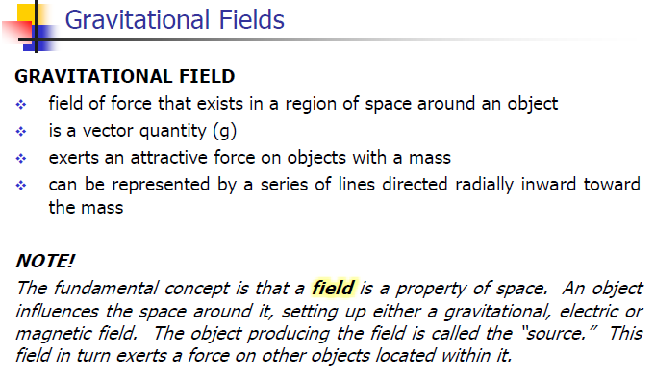

Slide 9
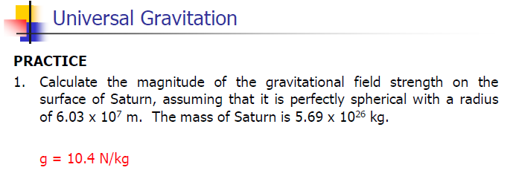

Slide 10
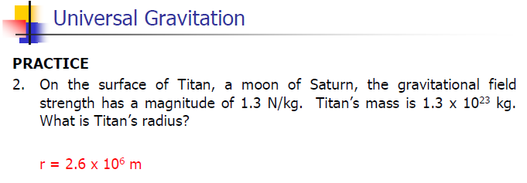

Slide 11
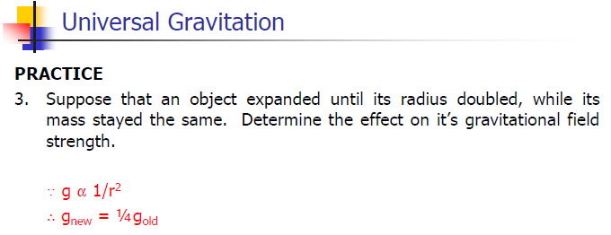

Slide 12
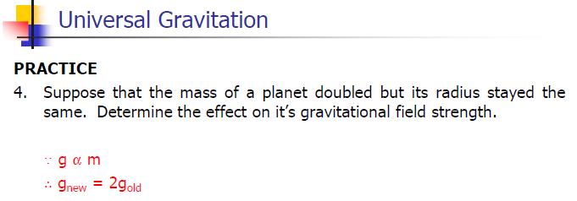

Slide 13
Classwork & Homework

