Slide 1
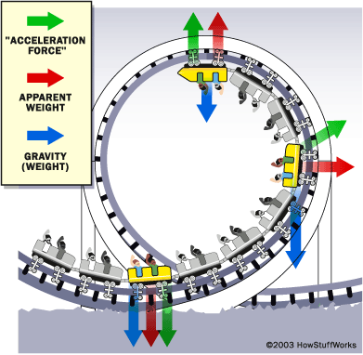
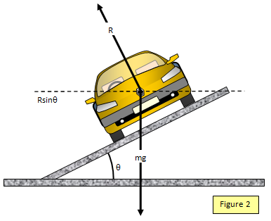
Ch3: Uniform Circular Motion
3.3 – Centripetal Force
(pg. 120-124)

Slide 2
Cars Driving with Centripetal Force (Not Centrifugal as the video suggests)
http://www.youtube.com/watch?v=hZOekFFSoWI

Slide 10
Centripetal Force - PlanetNutshell
https://youtu.be/KvCezk9DJfk

Slide 13
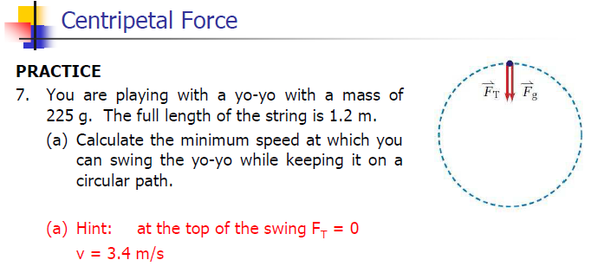

Slide 14
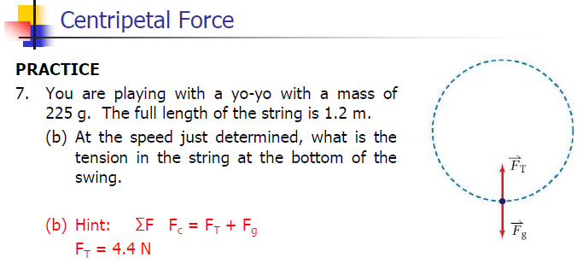

Slide 15
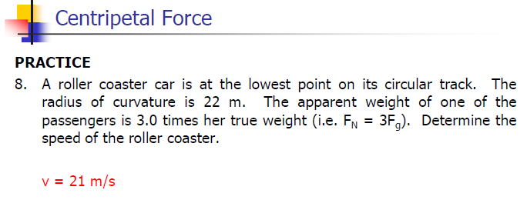

Slide 19
Classwork & Homework

