Slide 1
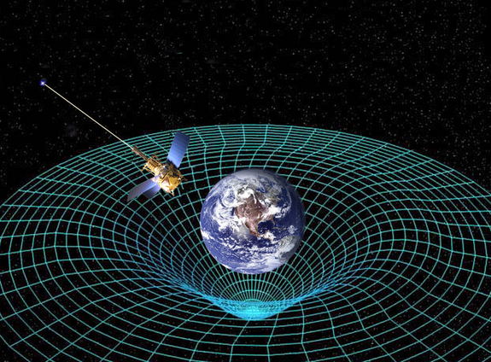
Ch11: Relativity
11.1 – The Special Theory of Relativity
(pg. 574-579)

Slide 9
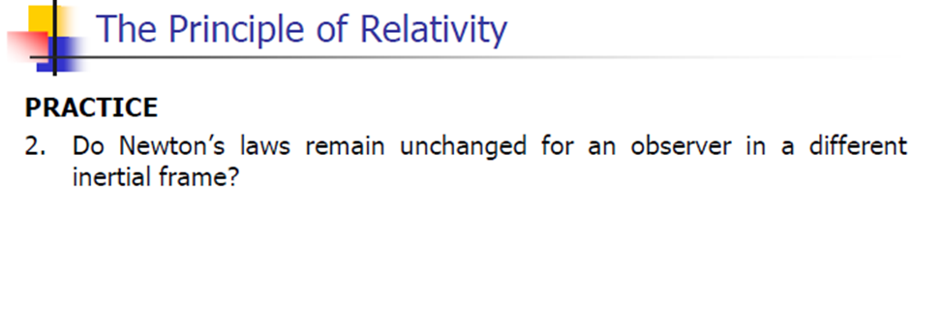

Slide 12
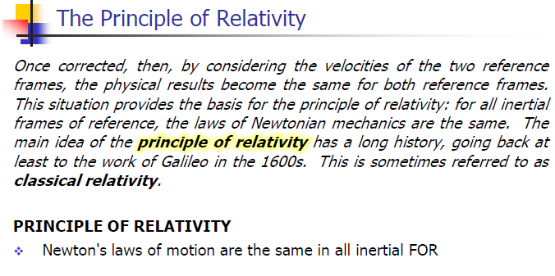

Slide 22
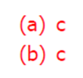

Slide 24
Classwork & Homework

