Slide 1
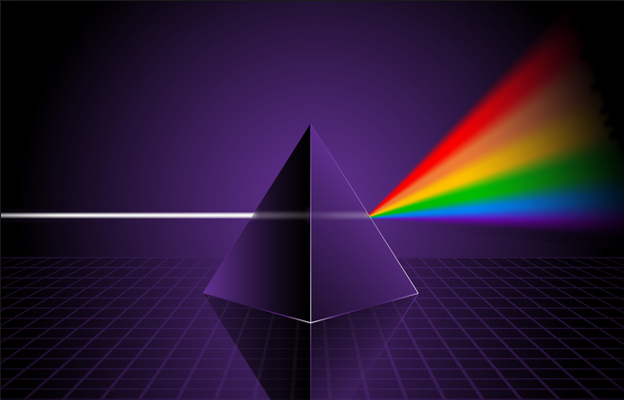
Ch9: Waves and Light
9.1 – Properties of Waves and Light (pg. 440-458)

Slide 5
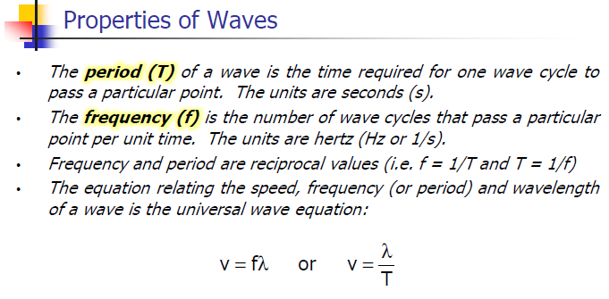

Slide 11
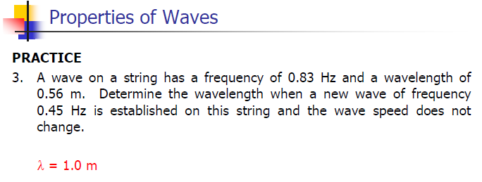

Slide 12
Classwork & Homework

