Slide 2
2.3 – Projectile Motion

Slide 11
The riverboat with current and without current
http://www.physicsclassroom.com/mmedia/vectors/rb.cfm

Slide 12
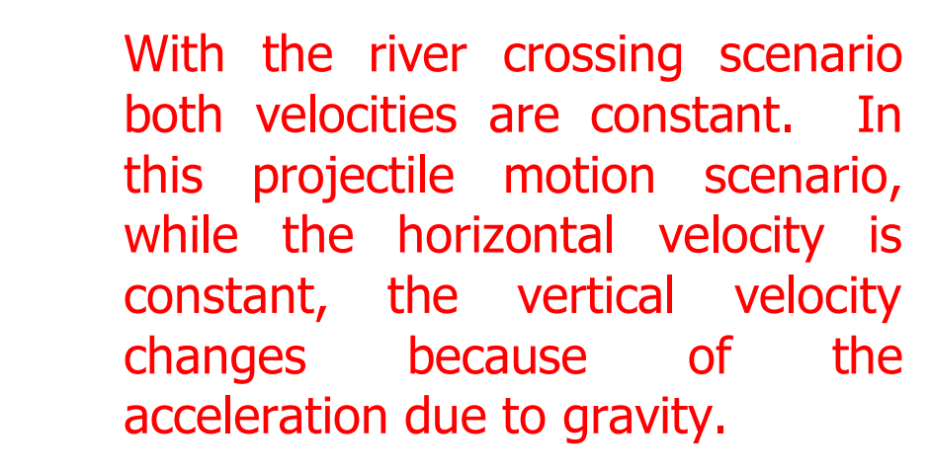

Slide 23
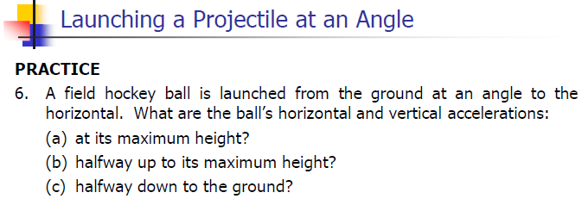

Slide 31
Projectile Motion PHET
http://phet.colorado.edu/sims/projectile-motion/projectile-motion_en.html

