Slide 1
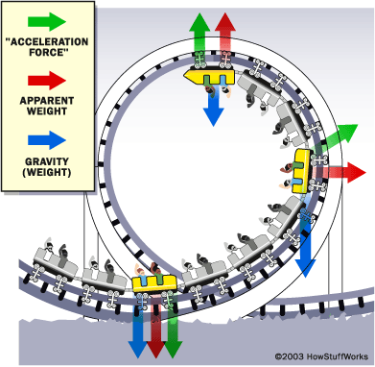
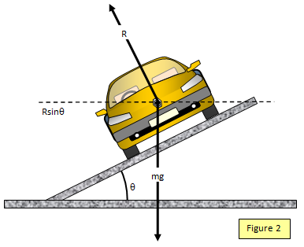
Ch3: Uniform Circular Motion
3.2 – Centripetal Acceleration
(pg. 114-119)

Slide 14
Classwork & Homework

