Slide 1
Unit 2: Energy & Momentum
Introduction (pg. 158-161)
Chapter 4: Work and Energy
Chapter 5: Momentum and Collisions

Slide 6
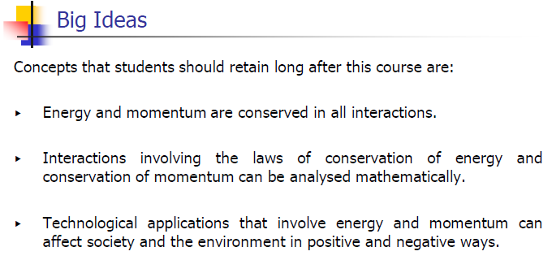

Slide 12
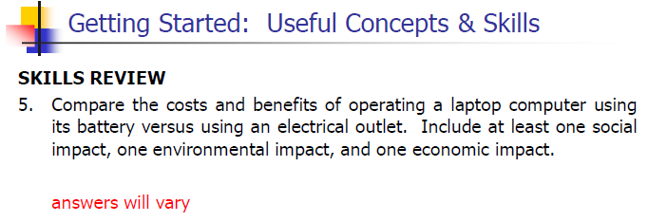

Slide 15
Classwork & Homework

