Slide 1
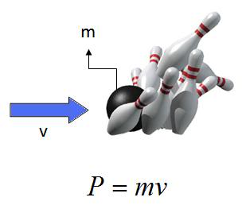
Ch5: Momentum & Collisions
5.4 – Head-on Elastic Collisions(pg. 240-248)

Slide 19
Classwork & Homework

