Slide 1
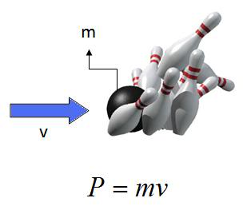
Ch5: Momentum & Collisions
5.3 – Perfectly Inelastic Collisions (pg. 236-239)

Slide 8
Classwork & Homework

