Slide 1
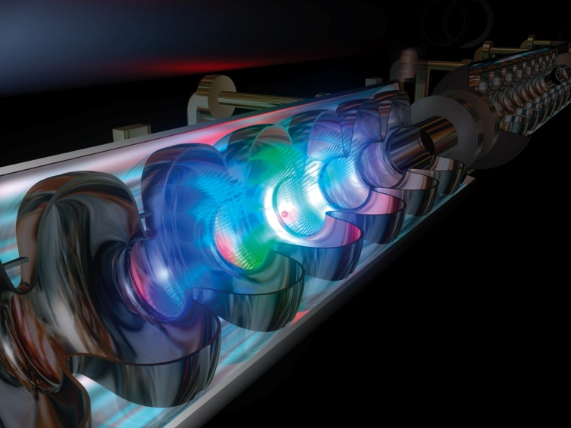
Ch8: Magnetic Fields
8.1 – Magnets and Electromagnets (pg. 378-385)

Slide 11
Aurora Borealis
http://www.youtube.com/watch?v=LL-Is9IV1nc

Slide 18
Electromagnetism

Slide 20
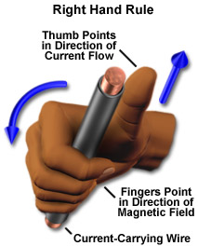
Right Hand Rule for a current carrying wire which generates a magnetic field
Right thumb in the direction of conventional current (I)
Curled fingers point in the direction of the magnetic field lines (B)

Slide 21
1. Magnetic Field of a Straight Conductor

Slide 23
3. Magnetic Field of a Coil or Solenoid

Slide 26
Classwork & Homework

