Slide 1
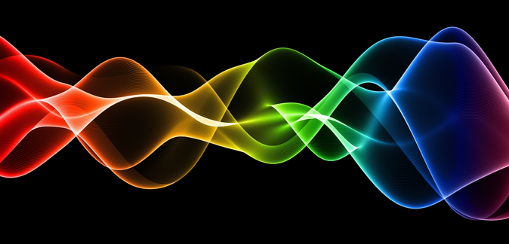
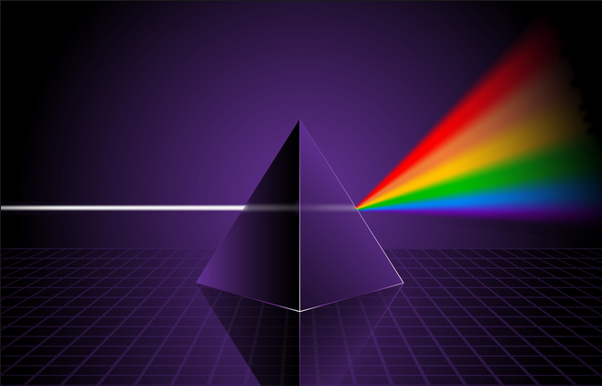
Ch10: Application of the Wave Nature of Light
10.4 – Electromagnetic Radiation (pg. 526-531)

Slide 35
Classwork & Homework

