Slide 1
The Rules of Lab Safety
Vaughan Secondary School

Slide 2
You are responsible
for your safety
and for the safety of those around you.
Failure to act in a safe and responsible manner will result in the removal of all science lab privileges.

Slide 3
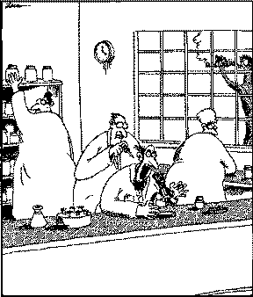
Horseplay will be dealt with severely!
Professor Glickman, the lab practical joker, deftly places a single drop of hydrochloric acid on the back of Professor Bingham's neck.
--Gary Larson, the Far Side

Slide 4
General Safety Precautions
No horseplay. Be aware of others in the lab.
No student should be in the lab or preparation room unsupervised. No unauthorized experiments.
Be prepared for your lab.
READ your procedure for any safety precautions before starting the lab.

Slide 5

General Safety Precautions (cont.)
Do not eat, drink, or chew gum in the lab.
Your food may pick up harmful chemicals.
Never taste (unless directed to) or
directly inhale chemicals.

Slide 6
General Safety Precautions (cont.)
Do not sit on the lab benches.
Please stand while doing labs.
Keep work area clean and free from clutter when performing experiments.
Butane lighters, matches, and other flammable materials must not be used by students in class.

Slide 7
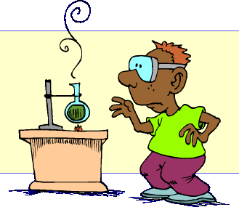
Safety Equipment
Safety goggles must be worn for all experiments. Contact lenses should not be worn; use prescription glasses with goggles instead.
Know the locations of all safety equipment in the lab: fire extinguishers, eye wash station, first aid kit, fire exits, and fire alarms.

Slide 8


Sharp Objects
  When using knifes or other sharp objects always walk with the points facing down.
  Cut away from fingers and body.
Electrical Safety
  Do not place a cord where someone can trip over it.
  Never use electricity around water.
  Unplug all equipment before leaving the room.

Slide 9
Safety Equipment (cont.)
Dress appropriately during a lab activity. Long hair must be tied back, and dangling jewelry and baggy clothing must be secured. Shoes must completely cover the foot. No sandals allowed on lab days.
Your teacher may require additional safety equipment, which must be worn. Be sure to READ your procedure.

Slide 10
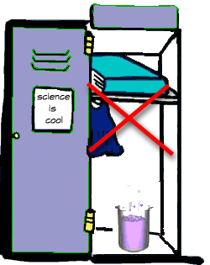
Handling Chemicals
All chemicals in the laboratory are to be considered dangerous.
Do not allow chemicals to come in contact with skin or eyes.
Do not taste, or smell any chemicals.
.
.
Check the label on all chemical bottles twice before removing any of the contents. Take only as much chemical as you need.

Slide 11
Handling Chemicals (cont.)
Never return unused chemicals to their original container.
No chemicals go down the drain. Dispose of chemicals as instructed by your teacher.
Never remove chemicals or other materials, including any equipment from the laboratory area.
Look for WHMIS or HHPS symbols on containers.
.
.

Slide 12
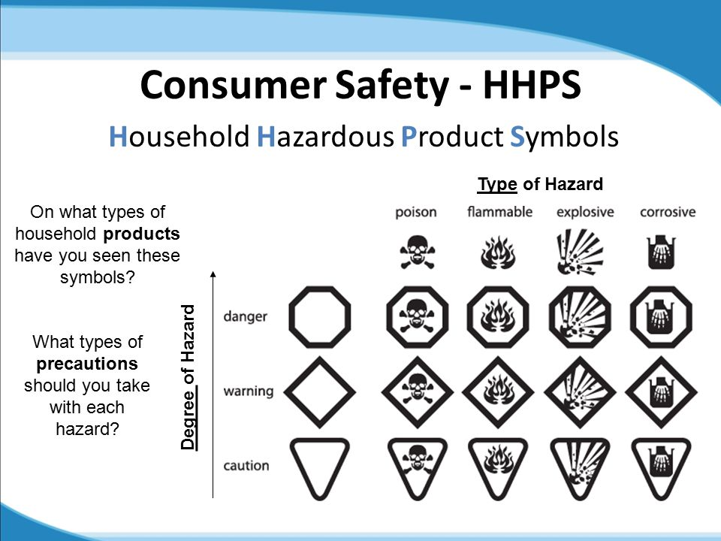

Slide 13




Hazardous Household Product Symbols
CORROSIVE
Eats or wears away other materials.
EXPLOSIVE
Explodes or gives off deadly vapours.
FLAMMABLE
Ignites if exposed to heat or sparks.
POISONOUS
May cause sickness or death if swallowed.

Slide 14
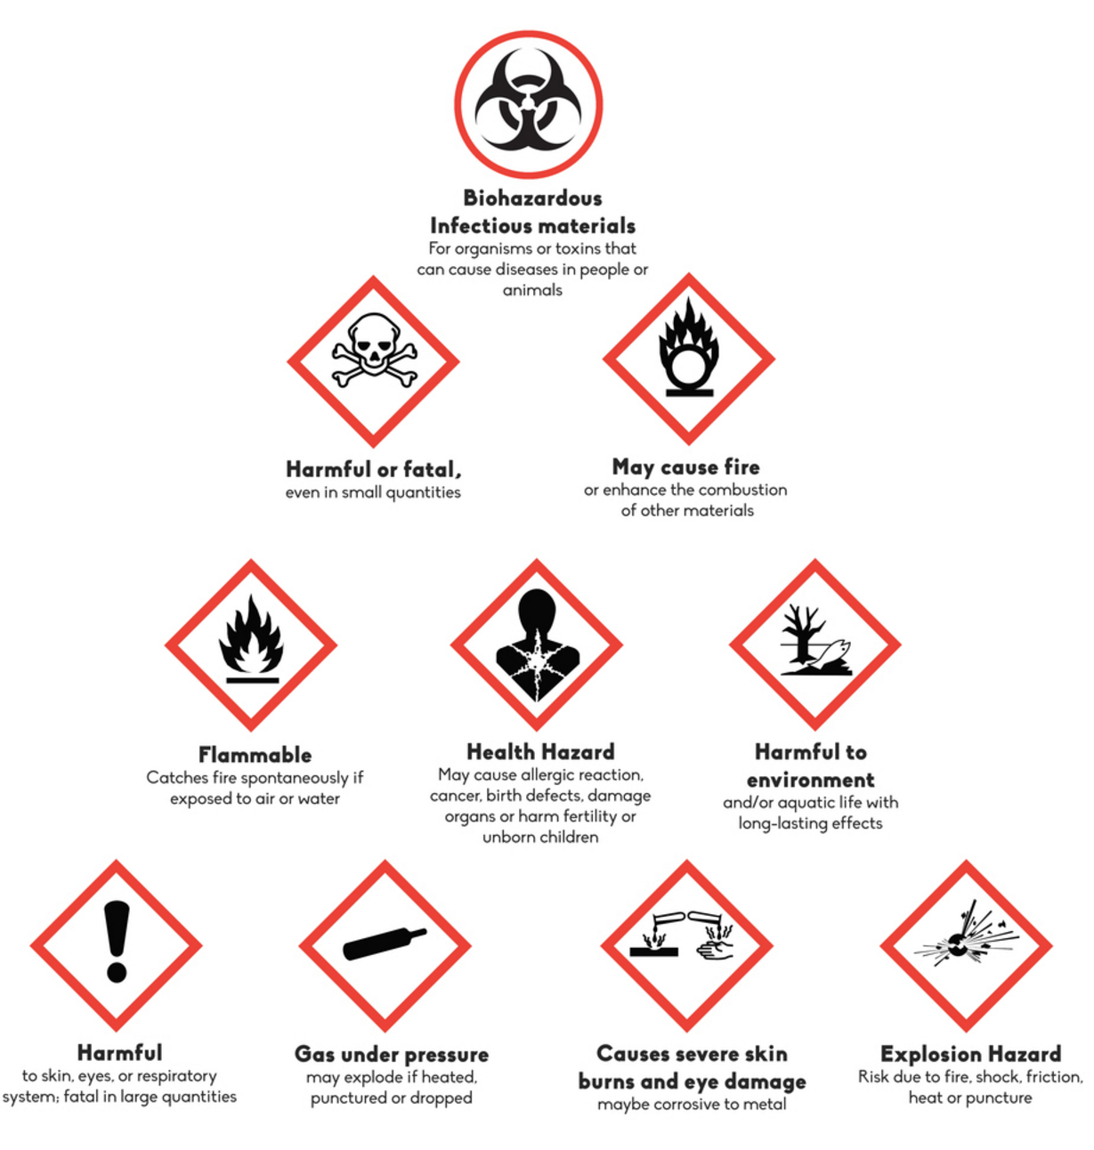
Workplace Hazardous Materials Information System
WHMIS

Slide 15

Handling Glassware
Do not use cracked or chipped glassware.
Do not tightly stopper a flask where gas is being created. It could explode.
Clean and return all glassware at the end of the lab.

Slide 16
Handling Glassware
Broken glass should be reported to the teacher who will give instructions for safe clean up and disposal. There is a designated glass disposal container.
If you can hear glass break, everyone should stop walking immediately.

Slide 17
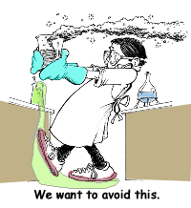
Heating Substances
Light a Bunsen burner as instructed by your teacher. Never leave a heat source unattended.
Hot glass does not look hot! Handle
recently heated glassware with tongs.

Slide 18
Heating Substances
Do not immerse hot glassware in cold water. The glassware may shatter.
When heating a test tube, always point the test tube away from yourself and others. Never look into a container that is being heated.

Slide 19
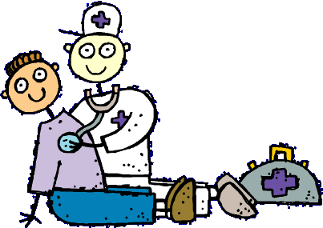
Accidents & Injuries
Respond to emergencies sensibly and immediately!
Report all accidents and injuries to the teacher at once, no matter how minor.
If chemicals are spilled on skin rinse well with running water for as long as directed by your teacher.

Slide 20
Accidents & Injuries (cont.)
For a chemical splash in your eyes, rinse immediately at the eye wash station for at least 30 minutes. Hold eyelids open.
If a chemical is spilled immediately inform a teacher and follow directions for safe clean up.
If a fire starts, inform a staff member immediately. Remember, if you are on fire, – STOP… DROP… ROLL!!!

Slide 21
Accidents & Injuries (cont.)
Fire Extinguisher – Note their location now!!!
To operate the fire extinguisher remember
P-A-S-S
P - Pull the Pin
A- Aim the hose at the base of the fire from 5-6 feet away.
S- Squeeze the handle.
S- Sweep the hose back and forth across the
fire.

Slide 22

When the lab is done . .
Dispose all waste only as instructed by your teacher
Clean all glassware and materials and put everything away according to instructions.
Wipe the lab benches clean with paper towels.
Disinfect safety goggles and return to designated storage.
Wash your hands with soap and water and return your materials.

Slide 23
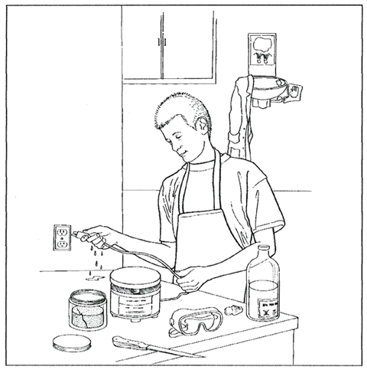
What’s Wrong with This Picture?

Slide 24
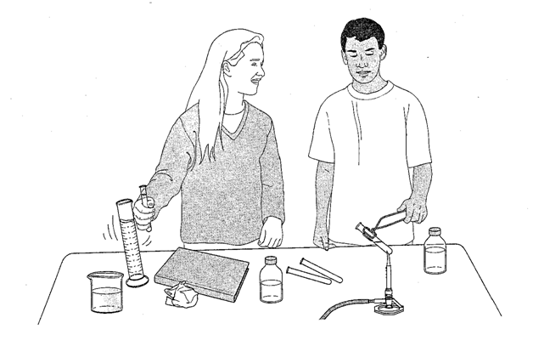
What’s Wrong with This Picture?

Slide 25
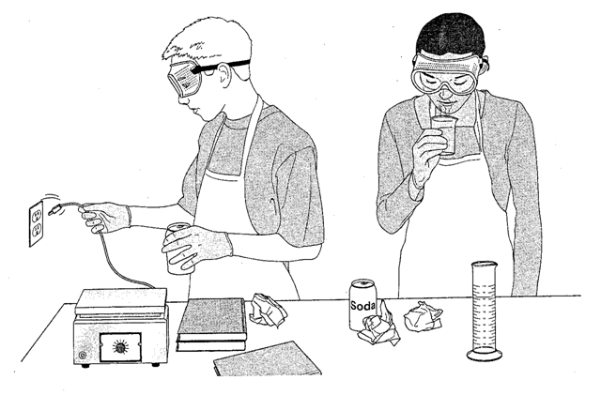
What’s Wrong with This Picture?

Slide 26
What To Do In An Emergency
If there is a fire or fire alarm
  Quietly get up and push in your chair.
  Head to the outside set of doors.
  Walk to the stairs and go down to the bottom floor.
  Walk to the closest sidewalk and wait for the teacher.
  Do not leave the rest of the class so that the teacher can account for every student.
  Please stay off of cell phones to listen to instructions

Slide 27
IF YOU’RE NOT SURE ABOUT SOMETHING…
Ask your TEACHER!!!!

