Slide 1
CH 6: Thermal Energy and Society
Review

Slide 2
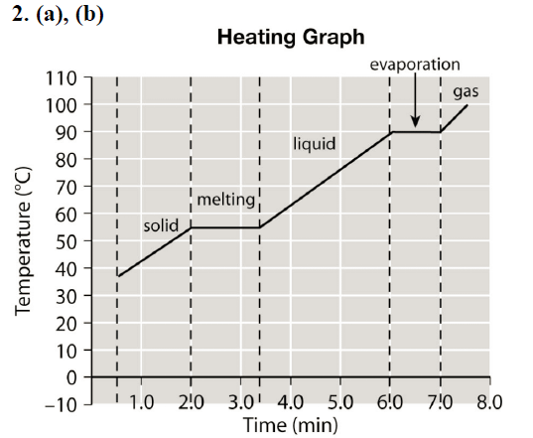
Section 6.4 pg. 295 #2

Slide 4
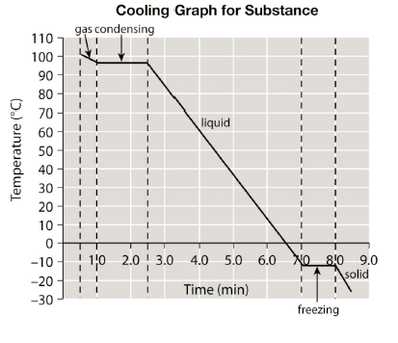
Review pg. 314 #74

