Slide 1
Accounting and Finance Review
Intro to Business BBI2O1

Slide 3
Question 1
Accounting is the process of recording and analyzing the financial or economic activities of a business? True or False.
False - Accounting is the process of recording, analyzing and interpreting the financial or economic activities of a business.

Slide 4
Question 2
A balance sheet shows the revenue and expenses for a period of time? True or False.
False – shows the financial position of a business on any given day.

Slide 5
Question 3
An asset is something that is owned and has economic value. True or False.
True

Slide 6
Question 4
Assets are ordered by:
Purchase date
Liquidity
Price
Importance
b) Liquidity – e.g. cash, accounts receivable, supplies, inventory, furniture, building and land

Slide 7
Question 5
An account receivable is:
A customer who makes a promise to pay later
An asset
Something that is owed to the business
All of the above
d) All of the above

Slide 8
Question 6
Assets are recorded at fair market value (their value on any given day). True or False
False – all assets are recorded at cost (the price paid for the asset) irrespective of its fair market value

Slide 9
Question 7
Expenses are expenditures made within an accounting period to earn revenue.
True or False
True

Slide 10
Question 8
Liabilities are listed:
In alphabetical order
By most important suppliers
When they are due
There is no order
c) When they are due – accounts payable are typically due within 30 days, bank loan 1 – 5 years and mortgages beyond that.

Slide 11
Question 9
The formula to calculate owner’s equity is
Liabilities – assets
Assets + liabilities
Owner’s equity – assets
Assets - liabilities
d) Assets – liabilities. Remember that the fundamental accounting equation is
Assets = Liabilities + Owner’s Equity

Slide 13
Question 10
Disposal Income is
The compensation that is received from all sources such as salaries, bonuses, etc.
The amount of money that is left over after taxes and personal necessities
The amount of money that households have to spend after taxes
None of the above.
c) The amount of money that households have to spend after taxes.

Slide 14
Question 11
Factors that influence our buying decisions include:
Price and quality
Status
Current trends
All of the above
d) All of the above

Slide 15
Question 12
A budget helps you to prioritize your spending and manage your money. True or False.
True – a budget is an itemized listing of all revenue or income and expenses for a certain period of time. It shows where the money is coming from and going. All businesses use budgets.

Slide 16
Question 13
Our tax system is progressive – the more you make the more you pay in income taxes.
True or False.
True – a person in Ontario making $40,000 will pay approximately 15% in taxes whereas a person making $100,000 will pay approximately 25% in incomes taxes.

Slide 18
Question 14
The difference between saving and investing is saving is putting money aside that earns a fixed rate of interest and is protected whereas investing earns a higher rate of return but your money is not protected. True or False.
True

Slide 19
Question 15
Interest is money that is paid of the use of borrowed or loaned money over a period of time. True or False.
True

Slide 20
Question 16
The following is an example of a simple interest calculation for an investment of 10,000 earning 5% interest per annum over a 2 year period:
Year 1 - 1 0,000 x 5% = 500
Year 1 total investment 10,000 + 500 = $10,500
Year 2 – 10,500 x 5% = 525
Year 2 total investment $10,500 + 525 = $11,025
True or False
False – the above represents a compound interest calculation. With simple interest - interest is earned on the original investment only. Compounding allows your investment to grow faster because interest is earned both on the original investment and the interest earned each year.

Slide 21
Question 17
The date when a bond is repaid is its:
Due date
Face value
Interest
Maturity
d) Maturity

Slide 22
Question 18
An individual who invests $200 monthly at an annual interest rate of 5% will have approximately ___________________ at the end of 35 years.
$84,000
$88,200
$176,400
$227,200
d) $227,200 –$84,000 is the principal or investment (200 x 12 x 35). The difference $227,200 – 84,000 is interest earned of $143,200 compounded monthly.

Slide 23
Question 19
Stocks are a good investment tool because they appreciate in value and pay dividends. True or False.
True

Slide 24
Question 20
Don’t put all your eggs in one basket is referred to as diversification. True or False.
True

Slide 25
Question 21
An investment vehicle created by the government that allows individuals to save for their retirement is a(n):
Mutual fund
Common stock
RRSP
RESP
c) RRSP

Slide 26
Question 22
A bear market reflects a market where stock prices are increasing. True or False.
False – A bull market refers to a market where stock prices are increasing.

Slide 27
Question 23
The Bank of Canada
Helps keep the Canadian economy stable
Controls the money supply
Is owned by the government
All of the above
d) All of the above

Slide 28
Question 24
Which financial institution is a Schedule II Bank?
Canadian Imperial Bank of Commerce
Deutsche Bank
HSBC
None of the above
c) HSBC

Slide 29
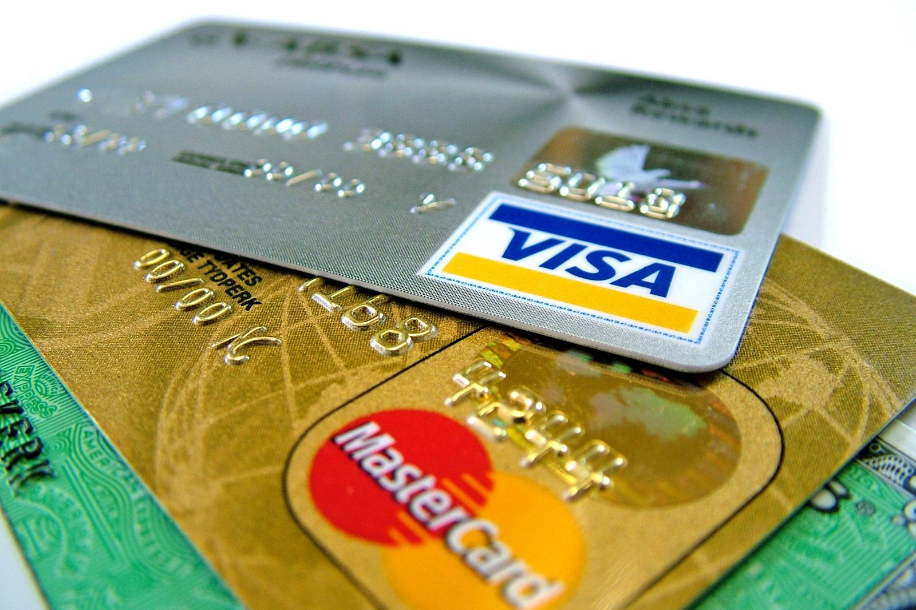

Slide 30
Question 25
Credit cards carry a lower rate of interest than do personal loans. True or False.
False – The average credit card interest rate is approximately 20% where the average personal loan rate is approximately 8%.

Slide 31
Question 26
A credit card only requires an individual to pay the minimum balance each month.
True or False.
True – Paying only the minimum balance is not a good strategy.

Slide 32
Question 27
An individual’s capacity to borrow is determined by:
The investments they hold
Whether they have a steady job
If they pay their bills on time
None of the above.
b) Whether they have a steady job

Slide 33
Question 28
An individual’s character is demonstrated by:
The investments they hold
Whether they have a steady job
If they pay their bills on time
None of the above.
c) If they pay their bills on time

Slide 34
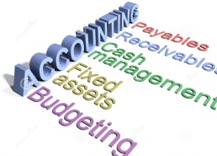
How did you do?
26 – 28 questions correct – Amazing! You are well on your way to ace the test.
21 – 25 questions correct – Very good! Be sure to focus additional review on the areas that you struggled with.
16 – 20 questions correct – Review all the PowerPoints and your lesson notes.
Less than 15 questions correct :( – Carefully review all the PowerPoints and your lesson notes and see your teacher for extra help.

Slide 35
Test Format
Review sheet

