Slide 1
CH 9: Wave Interactions
9.3 - Beats

Slide 2
Beats and Beats Frequency

Slide 7
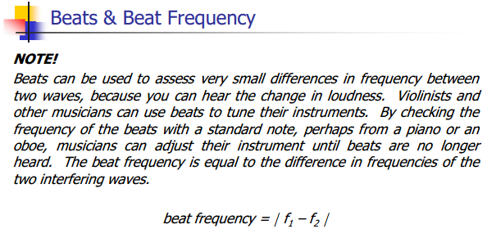

Slide 9
Notes:
253 Hz or 259 Hz

Slide 10
Classwork & Homework

