Slide 1
CH 9: Wave Interactions
9.2 – Waves at Media Boundaries Part 2

Slide 2
Agenda
Section 9.2 – Standing Waves between Free Ends and Fixed-Free Ends
Homework problems

Slide 15
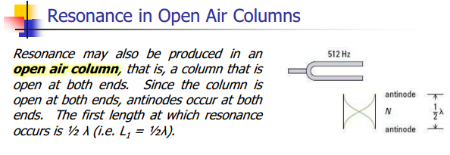

Slide 18
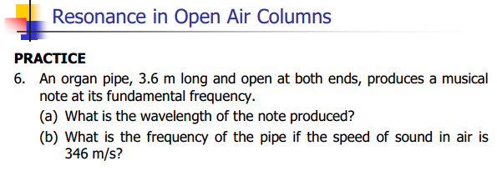

Slide 31
Classwork & Homework
Pg. 426 (#1-8)

