Slide 1
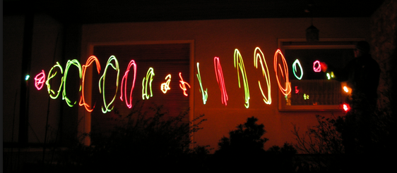
CH 8: Vibrations and Waves
8.3 – Wave Characteristics

Slide 2
Agenda
Take up homework problems
Electric ringer inside a bell jar
Section 8.3
Section 8.4
Textbook Problems

Slide 9
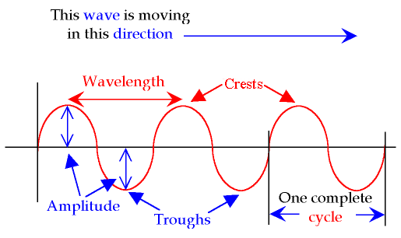

Slide 13
Notes:
a) Transverse b) A=8.5cm c) d=170cm

Slide 18
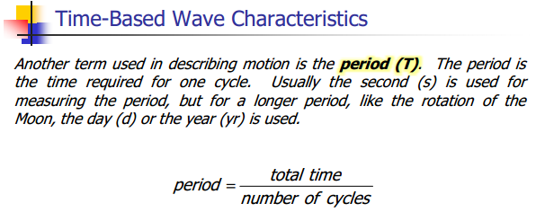

Slide 20
Notes:
a) f = 1.2Hz b) T=0.80s

Slide 21
Notes:
F = 75hz

Slide 22
Notes:
T=27.30d

Slide 24
Notes:
A and D

Slide 25
Notes:
AE and BF

Slide 26
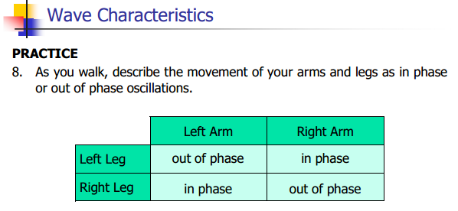

Slide 27
CH 8: Vibrations and Waves
8.4 – Determining Wave Speed

Slide 30
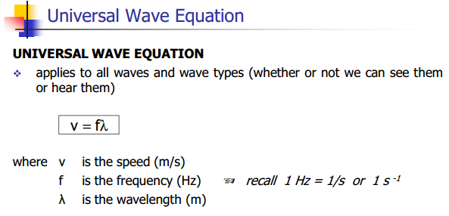

Slide 31
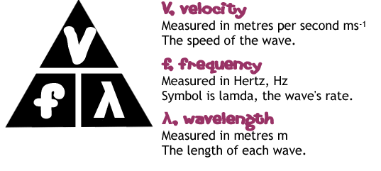

Slide 40
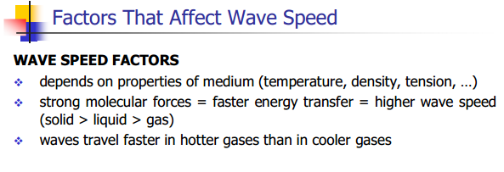

Slide 41
Classwork & Homework
Pg. 380 (#1-6) and Pg. 384 (#1-9)

