Slide 1
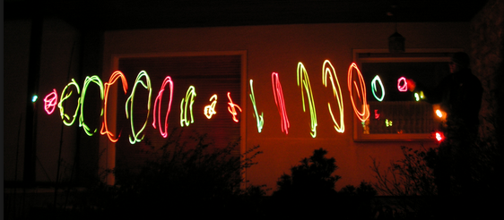
CH 8: Vibrations and Waves
8.3 – Wave Characteristics

Slide 6
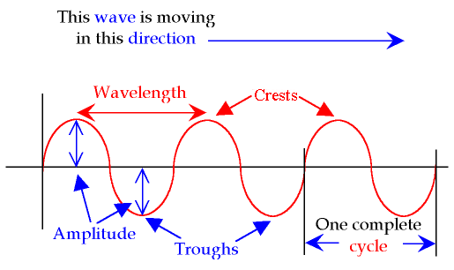

Slide 10
Notes:
a) Transverse b) A=8.5cm c) d=170cm

Slide 15
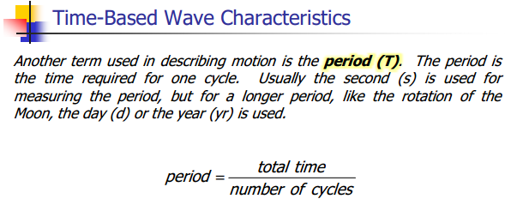

Slide 17
Notes:
a) f = 1.2Hz b) T=0.80s

Slide 18
Notes:
F = 75hz

Slide 19
Notes:
T=27.30d

Slide 21
Notes:
A and D

Slide 22
Notes:
AE and BF

Slide 23
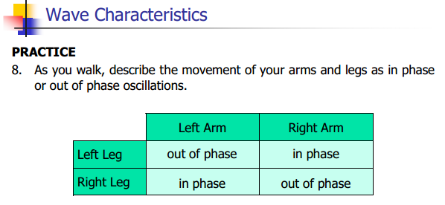

Slide 24
CH 8: Vibrations and Waves
8.4 – Determining Wave Speed

Slide 27
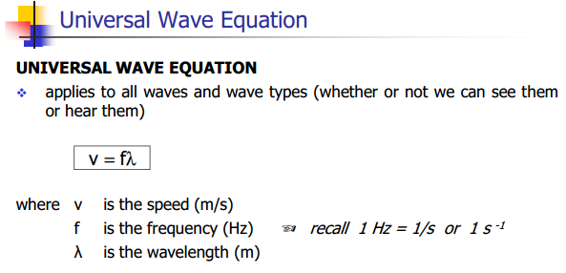

Slide 28
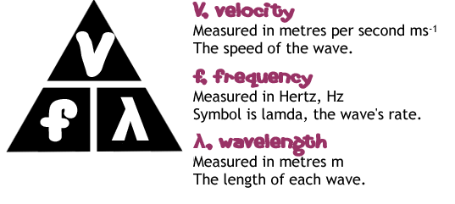

Slide 37
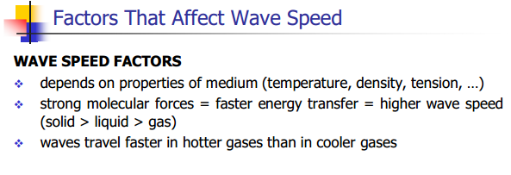

Slide 38
Temperature

Slide 39
Linear Density

Slide 40
Tension

Slide 41
Practice #1 (pg. 391)

Slide 42
Practice #2 (pg. 391)

Slide 43
Practice #3 (pg. 391)

Slide 44
Classwork & Homework

