Slide 1
CH 8: Vibrations and Waves
8.1 – What is a vibration

Slide 2
Agenda
Section 8.1
Section 8.2
Textbook Problems

Slide 3
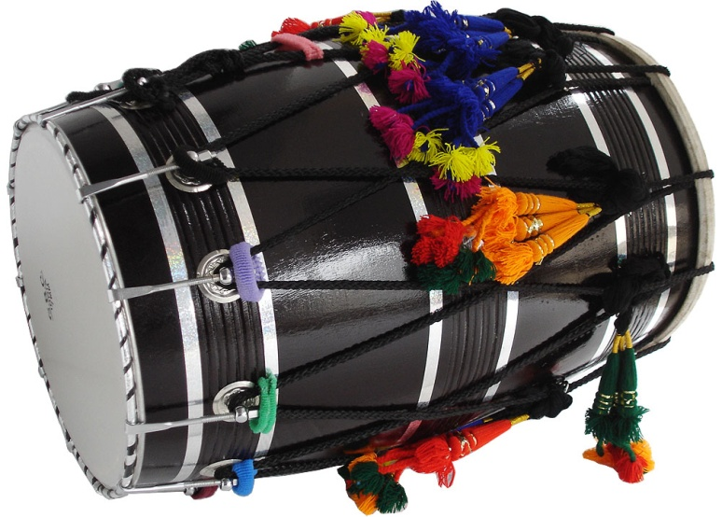
Vibrations & waves

Slide 4
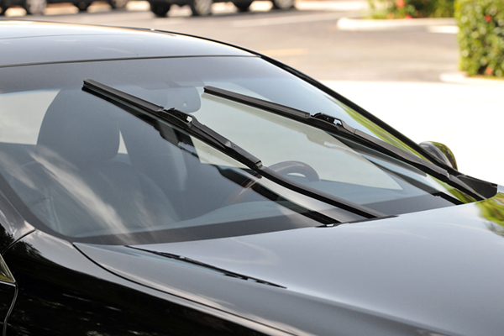
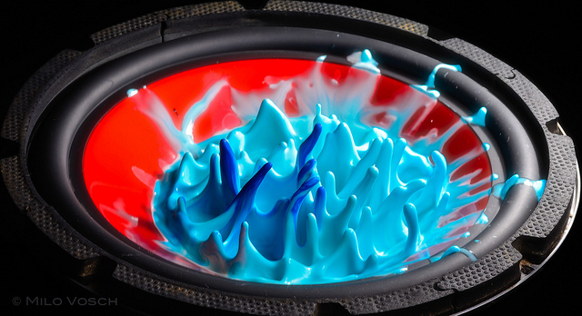
Vibrations

Slide 13
CH 8: Vibrations and Waves
8.2 – Types of Mechanical Waves

Slide 21
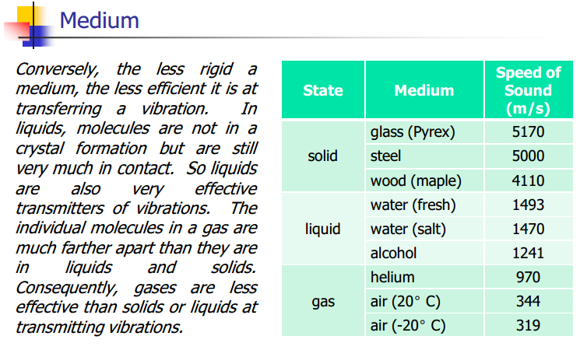

Slide 22
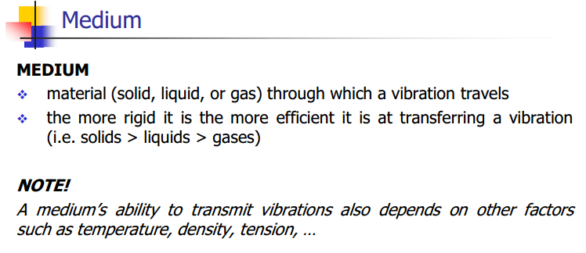

Slide 28
Bill Nye – Sound Travels in Waves:
http://www.youtube.com/watch?v=ACeUO4ufx2I

Slide 29
Transverse waves vs. Longitudinal waves
http://www.youtube.com/watch?v=7cDAYFTXq3E

Slide 35
Classwork & Homework
Pg. 380 (#1-6) and Pg. 384 (#1-9)

