Slide 1
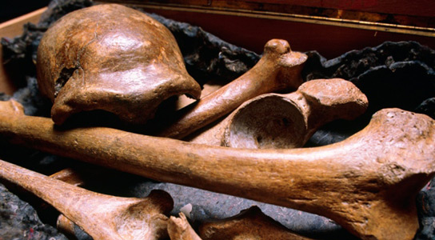
CH 7: Nuclear Energy and Society
7.3 – Half Life (pg. 330 – 333)

Slide 11
Half-Life Equation

Slide 12
Practice #1 (pg.332)

Slide 13
Practice #2 (pg.332)

Slide 14
Classwork & Homework

