Slide 1
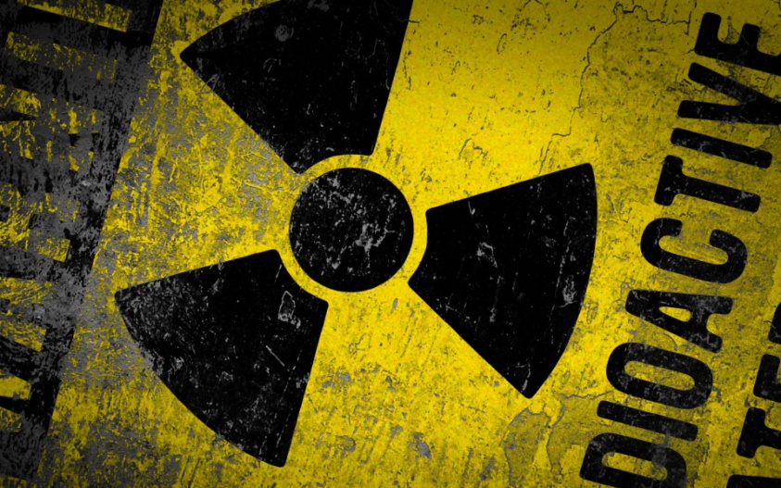
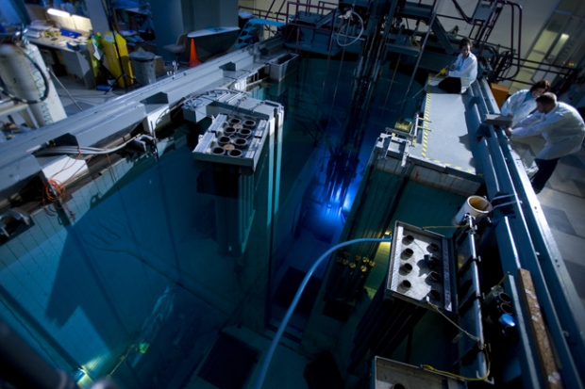
CH 7: Nuclear Energy and Society
7.2 – Radioactive Decay (pg.323-329)

Slide 2
Agenda
Section 7.2
Textbook Problems

Slide 18
Classwork & Homework
Pg. 322 Questions (#1-10)

