Slide 1
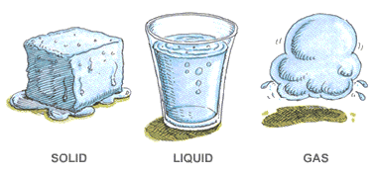
CH 6: Thermal Energy and Society
6.4 – States of Matter and Changes of States(pg. 288-295)

Slide 20
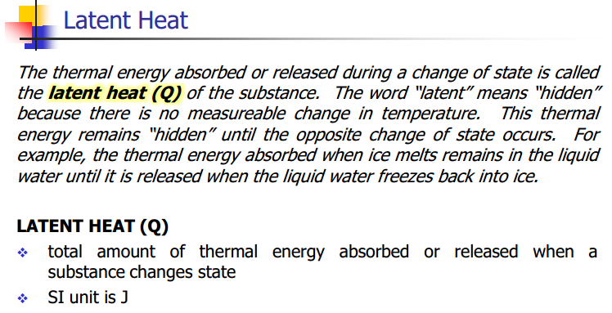

Slide 21
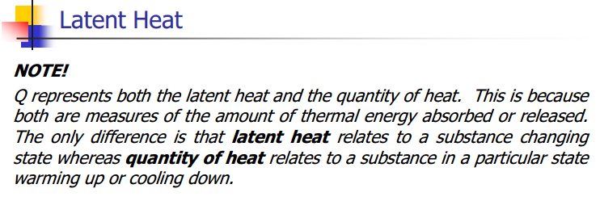

Slide 22
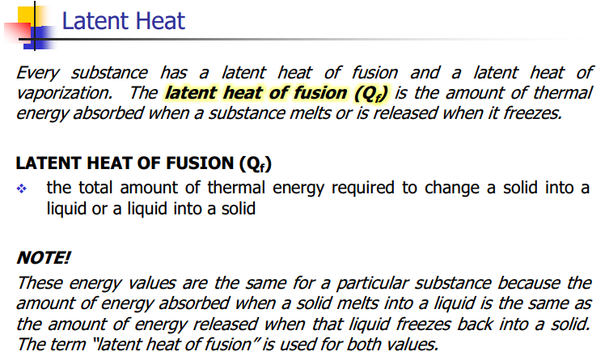

Slide 26
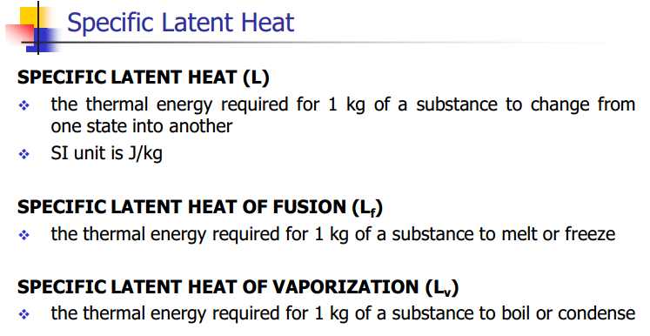

Slide 27
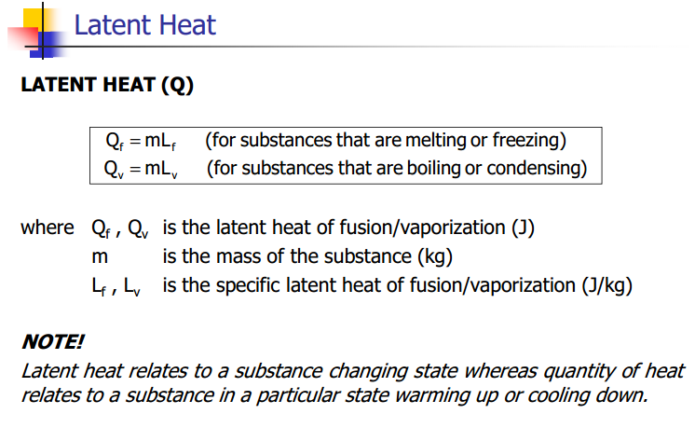

Slide 28
Practice #1 (pg.293)

Slide 29
Practice #2 (pg.293)

Slide 30
Practice #3 (pg.293)

Slide 31
Classwork & Homework

