Slide 1
CH 6: Thermal Energy and Society
6.3 – Heat Capacity (pg. 281-287)

Slide 2
Agenda
Finish off Energy Symposium
Section 6.3
Textbook Problems

Slide 6
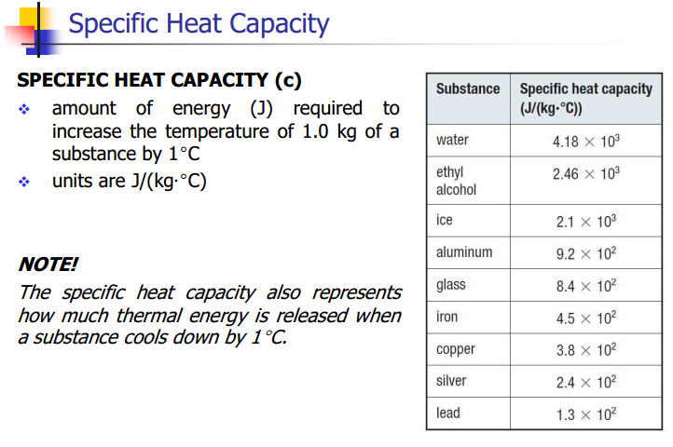

Slide 9
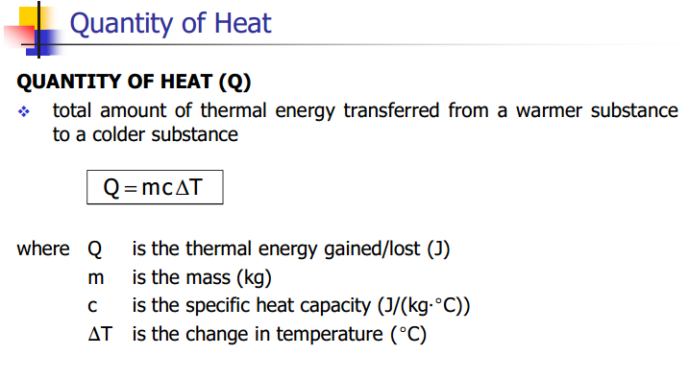

Slide 15
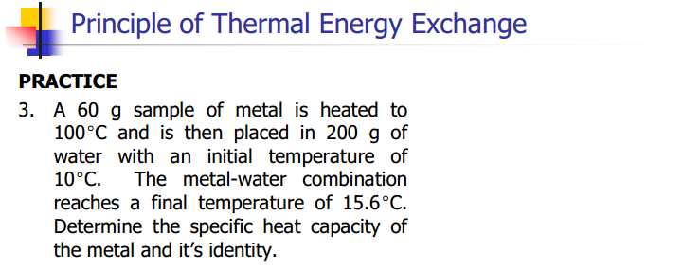

Slide 16
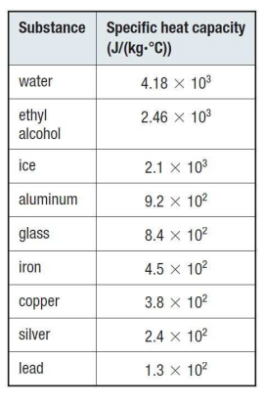

Slide 20
Classwork & Homework
Pg. 287 Questions (#1-10)

