Slide 1
CH 6: Thermal Energy and Society
6.3 – Heat Capacity (pg. 281-287)

Slide 5
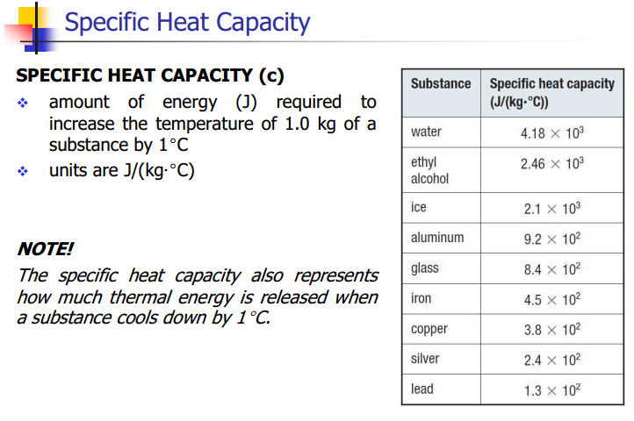

Slide 8
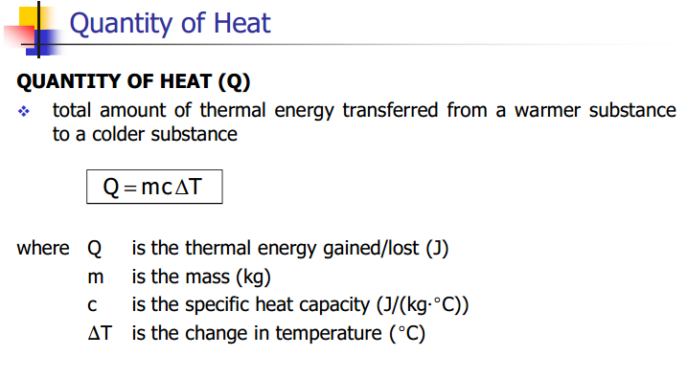

Slide 19
Classwork & Homework

