Slide 1
CH 6: Thermal Energy and Society
6.1 – Warmth & Coldness (pg. 270 - 274)
6.2 – Heat (pg. 275 – 280)

Slide 4
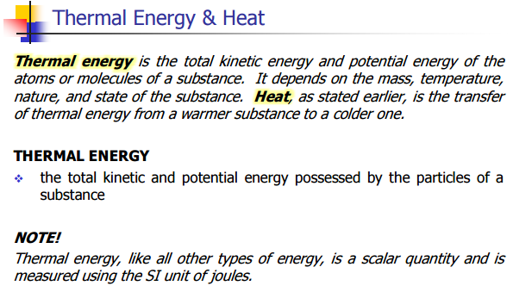

Slide 5
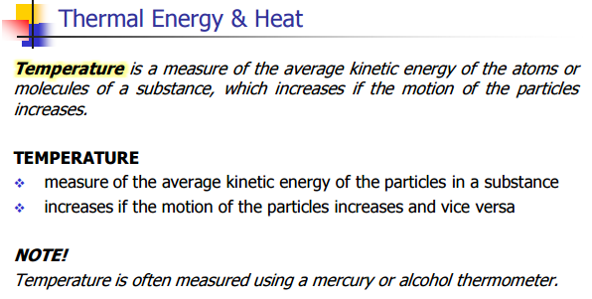

Slide 19
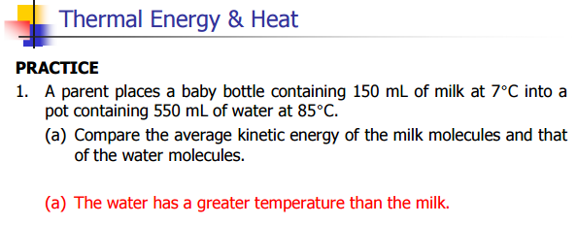

Slide 21
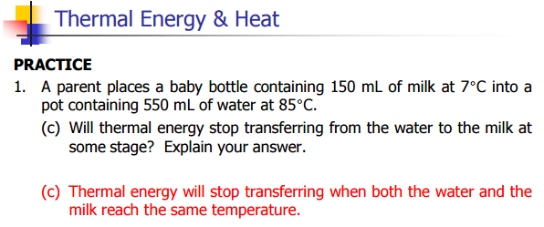

Slide 24
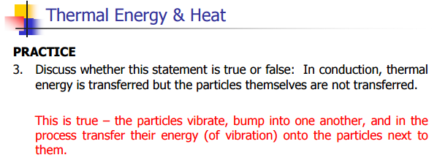

Slide 25
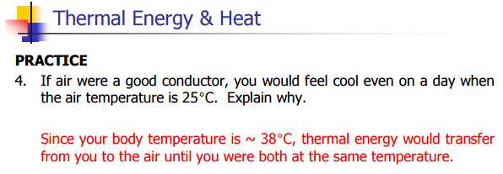

Slide 26
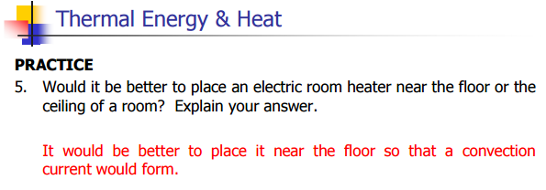

Slide 27
Classwork & Homework

