Slide 1
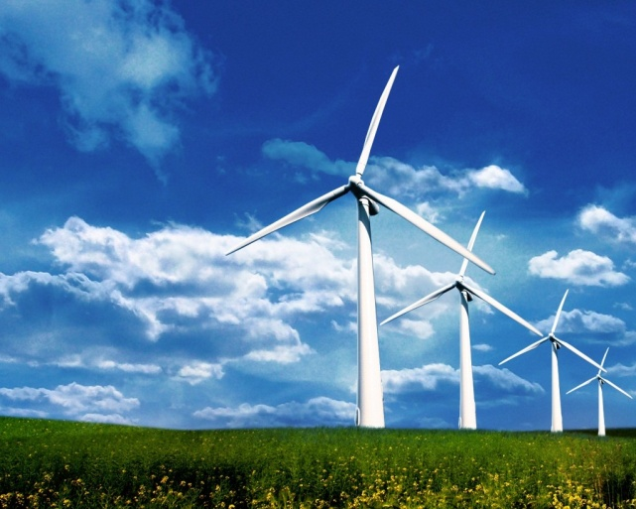
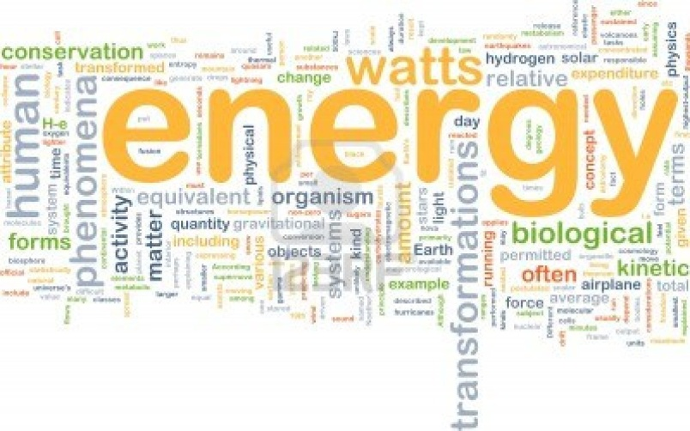
CH 5: Work, Energy, Power, and Society
5.5 – Power (pg. 250 – 254)

Slide 2
Agenda
Section 5.5
Homework Problems

Slide 6
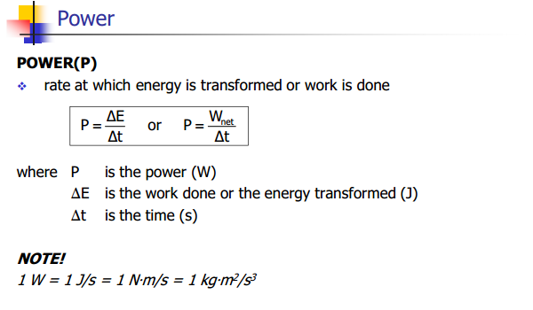

Slide 8
Practice Question #1 (pg. 251)

Slide 9
Practice Question #2 (pg. 251)

Slide 10
Practice Question #3 (pg. 251)

Slide 14
Practice Question (pg.253) #1

Slide 15
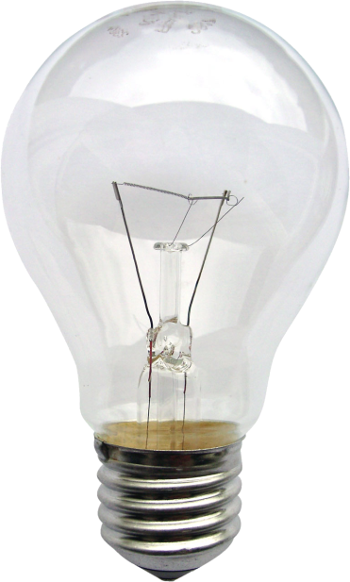
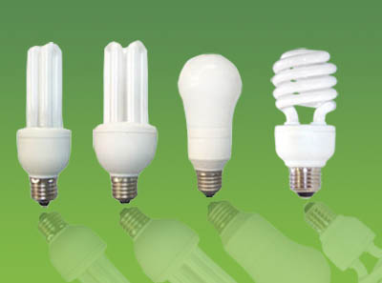

Slide 17
Classwork & Homework
Pg. 254 Questions (#1-5)
Study for Test

