Slide 1
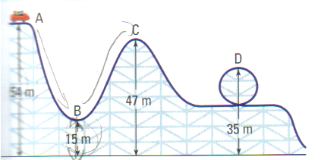
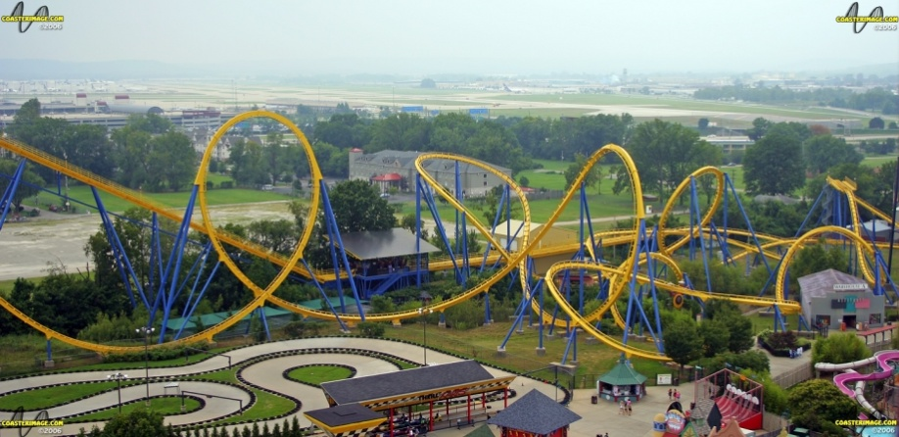
CH 5: Work, Energy, Power, and Society
5.4 – Efficiency & Sources of Energy
(pg. 242-249)

Slide 2
Agenda
Questions from H.W?
Quiz
Section 5.4
Homework Problems

Slide 3
Mechanical Energy Conservation Video Professor Walter Lewin
Wrecking Ball
http://www.youtube.com/watch?v=My2FRPA3Gf8
http://www.youtube.com/watch?v=mhIOylZMg6Q

Slide 7
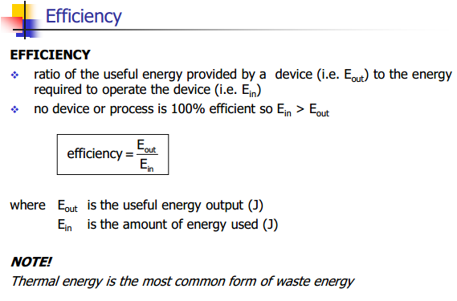

Slide 8
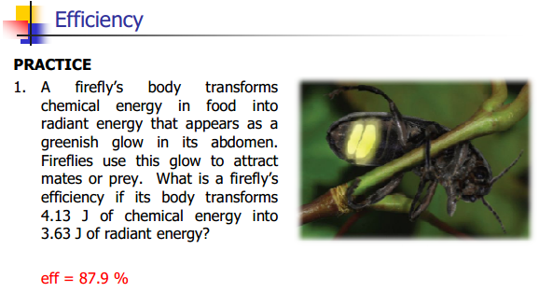

Slide 16
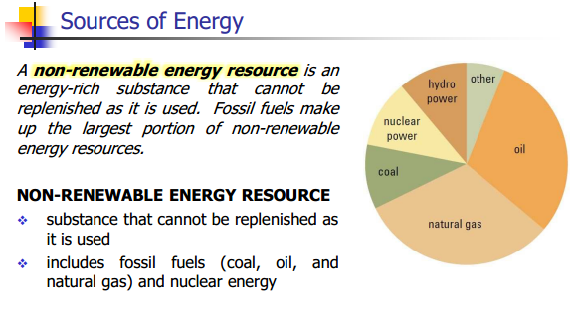

Slide 29
Classwork & Homework
Pg. 249 #

