Slide 1
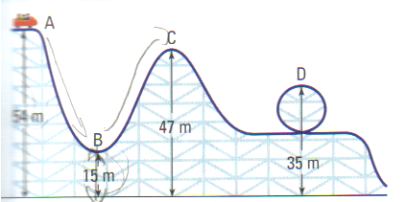
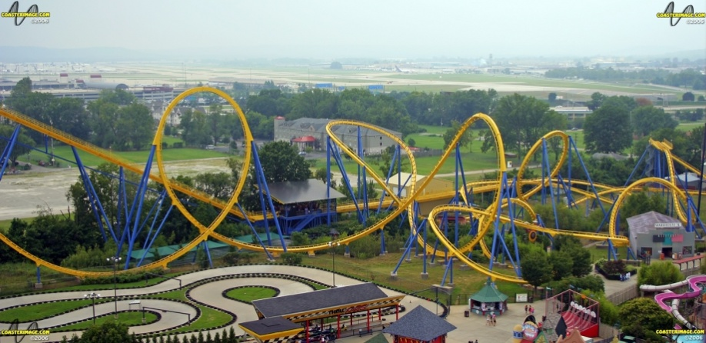
CH 5: Work, Energy, Power, and Society
5.3 – Types of Energy and the Law of Conservation of Energy

Slide 2
Agenda
Hand-In all Lab Reports
Questions from H.W?
Section 5.3
Go over Rocket ISU
Homework Problems

Slide 8
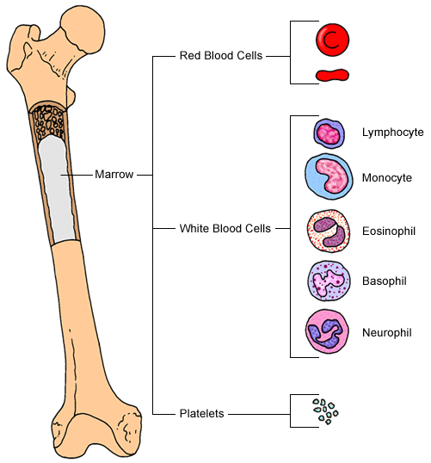

Slide 10
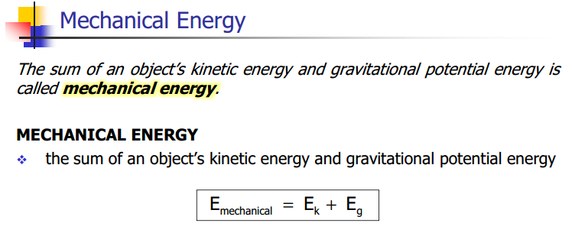

Slide 12
Mechanical Energy Conservation Video Professor Walter Lewin
Wrecking Ball
http://www.youtube.com/watch?v=My2FRPA3Gf8
http://www.youtube.com/watch?v=mhIOylZMg6Q

Slide 40
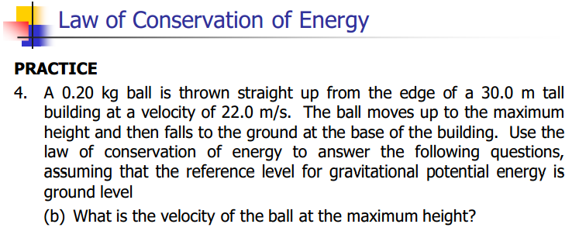

Slide 41
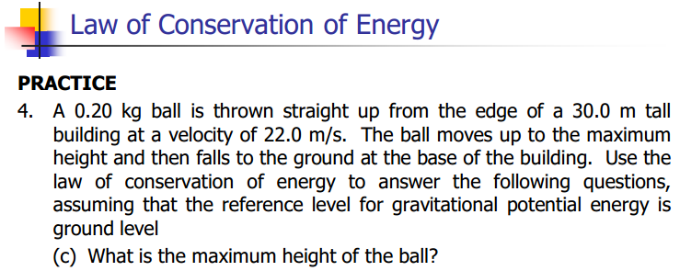

Slide 42
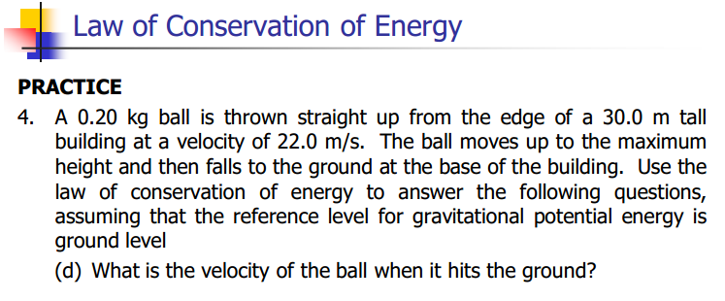

Slide 43
Classwork & Homework
Study for Quiz
Pg. 241 #1-4

