Slide 1
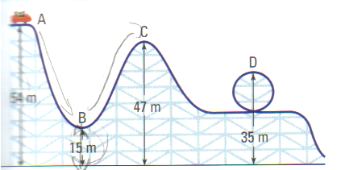
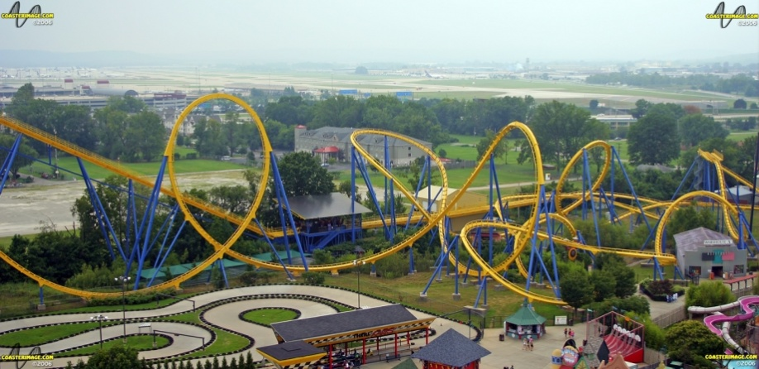
CH 5: Work, Energy, Power, and Society
5.3 – Types of Energy and the Law of Conservation of Energy

Slide 28
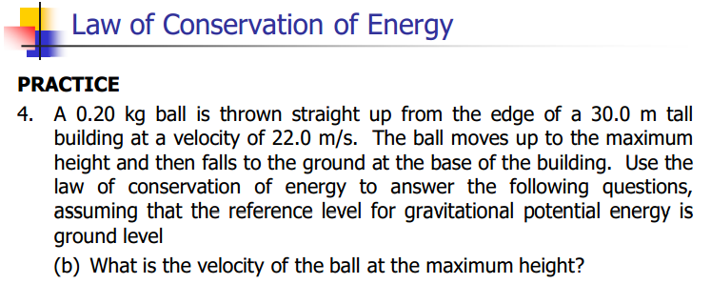

Slide 29
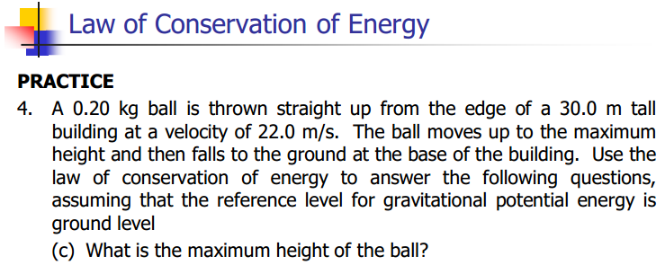

Slide 30
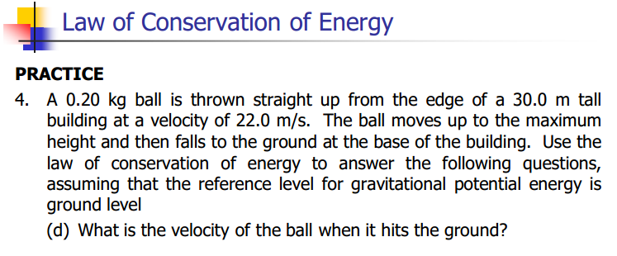

Slide 32
Classwork & Homework

