Slide 1
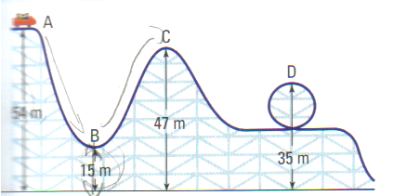
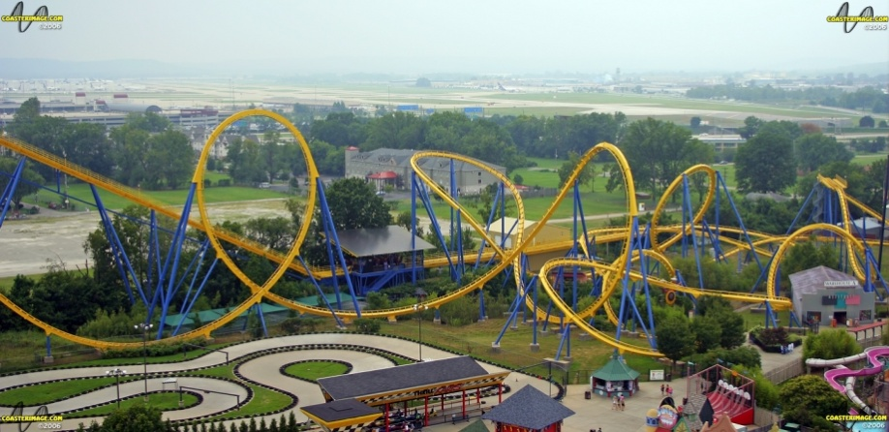
CH 5: Work, Energy, Power, and Society
5.2 - Energy

Slide 6
Derivation of Kinetic Energy

Slide 7
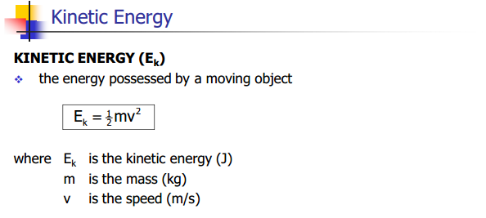

Slide 10
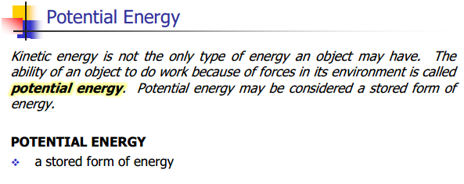

Slide 13
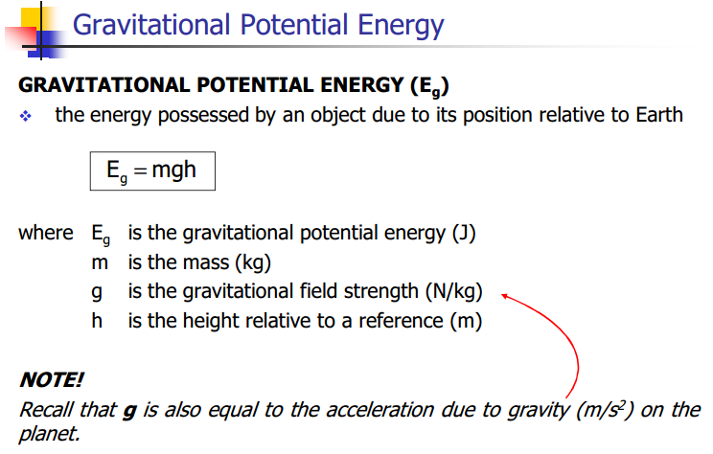

Slide 18
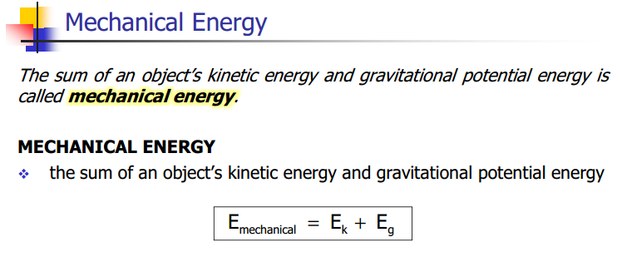

Slide 20
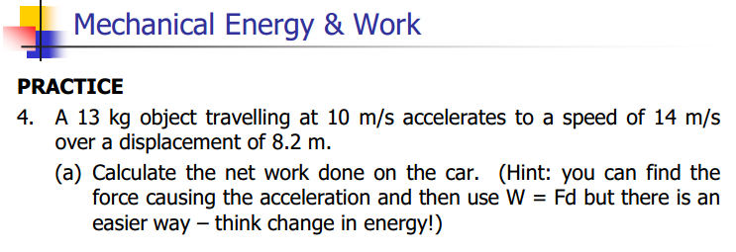

Slide 22
Mechanical Energy Conservation Video Professor Walter Lewin
http://www.youtube.com/watch?v=mhIOylZMg6Q

Slide 23
Classwork & Homework

