Slide 1
Going into Business
Learning Goal:
I will be able to list and discuss eight factors a person needs to consider before opening a business.
BBI2O – AHS September 2012

Slide 2
Going into Business: Eight Questions to Ask

Slide 3
#1) Why start your own business?
be your own boss
make decisions
be creative
make money
use skills and knowledge

Slide 4
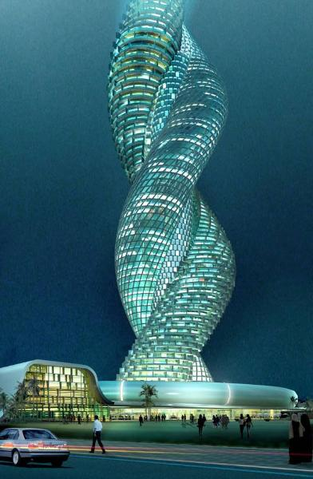
#2) What different types of businesses are there?

Slide 5
#3a) What are your skills and interests?
You can't build a reputation on what you're going to do.
Henry Ford
Failure is nature’s plan to prepare you for
greater responsibility.
Unknown
Genius is one percent inspiration and
ninety-nine percent perspiration.
Thomas Edison
Knowing is not enough we must apply.
Willing is not enough, we must do.
Johann Wolfgang von Goethe
The best way to predict the future is to create it.
Peter F. Drucker

Slide 6
#3b) Will your business be home based?
fewer meetings to attend
no office politics
more time spent on phone
wear casual clothes
technologically advanced: computer, scanners, video equipment, camcorders
not everyone likes working from home: personal contact or discipline, thinking & working differently

Slide 7
#3c) Will your business be web based?
home means less meetings - online
e-commerce – not meeting face to face
24/7 instead of 12 hours for 6 days
website hits tell how popular a web-based business is
all businesses need websites to conduct transactions online
web pages necessary to advertise what’s being sold
web page designers get hired to design good websites & advertisements for larger businesses but smaller businesses do it themselves
consumers are cautious about buying goods online

Slide 8
#4) Where can you find information about starting a business?
free sources of information
libraries
existing businesses
trade associations
government resources
internet
Industry Canada – Strategies for Canadian businesses & consumers
Statistics Canada – collects statistical data – example Canada’s GDP

Slide 9
#5) What are the start-up costs and where can you find financing?
Start up costs may include:
mortgage
salaries
advertising
equipment
goods
money for day-to-day operations

Slide 10
#5b) What are the start-up costs and where can you find financing?
Two kinds of financing:
debt – borrowing money
must be repaid
equity – owner(s) invests
Where to find financing:
financial institutions
credit history
business plan: success; owner experience
private investors

Slide 11
#6) What level of risk can you expect?
customers may refuse to pay
business partner may make an unacceptable deal
an employee may fail to do the job
supplier may be late with merchandise
might use a product that doesn’t work
may make a lot of money in the beginning
location may be bad
may be hard to compete with other businesses

Slide 12
#7) What steps are involved in running the business?
raw materials needed
location of your suppliers
availability of materials
number of employees & their positions
paying off the debt

Slide 13
#8) What resources will you need?
some supplies you may need:
cash
furniture & fixtures
computers
tools
vehicles
learn to forecast
calculate projected revenue/profit every 3 months

Slide 14
OMG
http://www.cbc.ca/dragonsden/2012/02/omg-candy.html
What reasons did the dragon’s give for not wanting to invest in OMG?

Slide 15
Activity
Individually answer question #s
11-17 found on page 61 of your
text book.

