Slide 1
4.4 – Forces Applied to Automotive Technology

Slide 2
2012 Mercedes-Benz ML350 Safety Features
https://www.youtube.com/watch?v=jYPULGbELF8

Slide 3
What Safety Features Does Your Car Have?
https://www.youtube.com/watch?v=GCNcgivDDMg

Slide 4
Car Tech 101: How tires work
https://youtu.be/BPYxLeW6WjM

Slide 5
CAA | Buying tires for your vehicle
https://youtu.be/Pw6rvlUp6jk

Slide 7
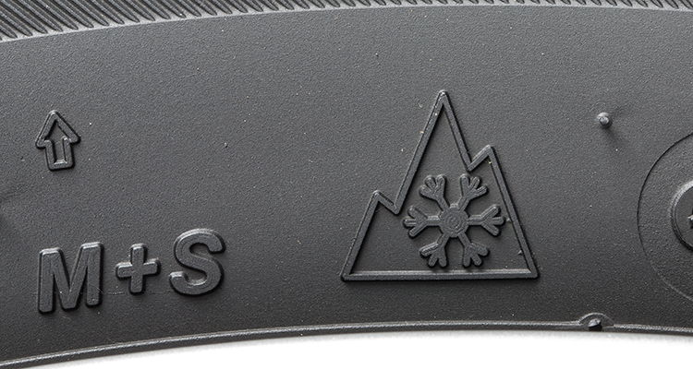
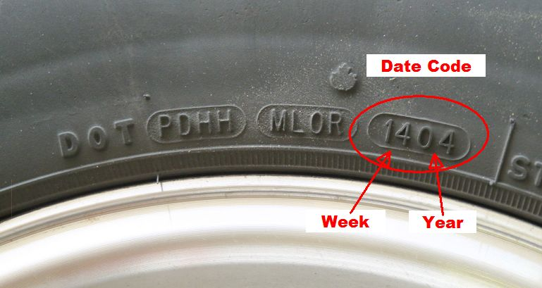

Slide 8
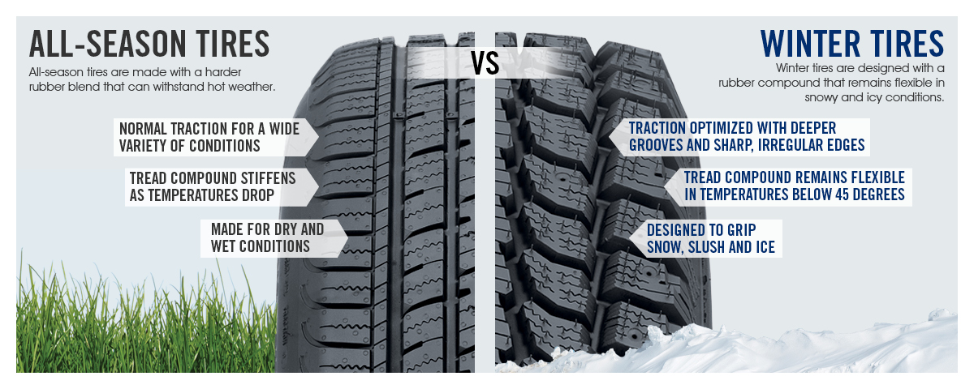

Slide 9
Winter Tires vs. Summer Tires
https://www.youtube.com/watch?v=elP_34ltdWI

Slide 10
How to check your tire tread with a coin
https://youtu.be/_xJxY04cZkk

Slide 11
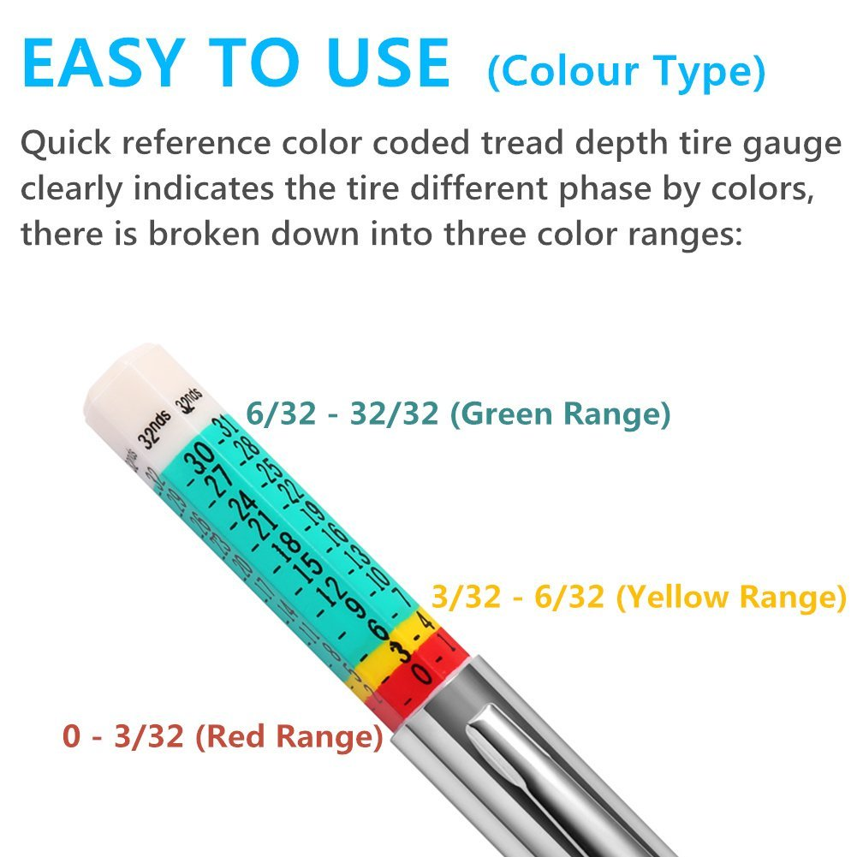
How to check your tire tread with a gauge
https://youtu.be/1ZfOyod0eqM

