Slide 1
CH 3: Newton’s Laws of Motion
3.5 – Using Newton’s Laws

Slide 2
Newton’s Laws of Motion and Forces (Tiros Educational)
https://www.youtube.com/watch?v=NYVMlmL0BPQ

Slide 3
Newton’s 3 Laws with a bicycle - TedEd
https://youtu.be/JGO_zDWmkvk

Slide 4
Action-Reaction Problems

Slide 7
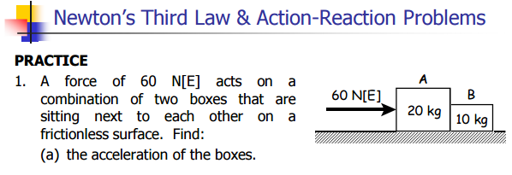

Slide 9
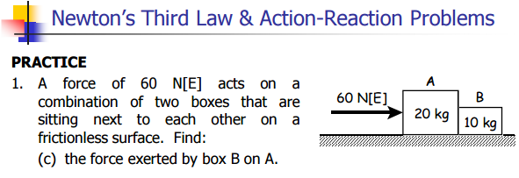

Slide 13
