Slide 1
CH 3: Newton’s Laws of Motion
3.2 Newton’s 1st law of Motion

Slide 8
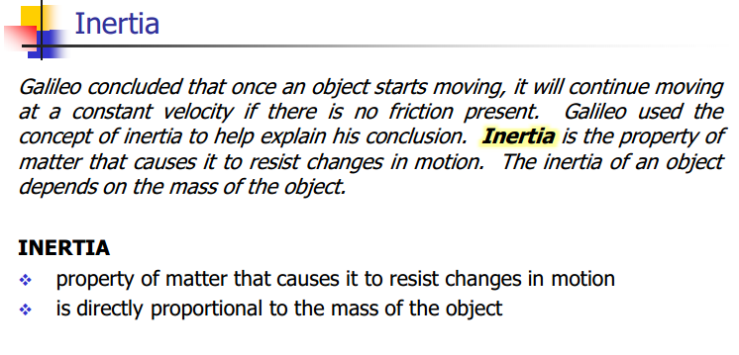

Slide 14
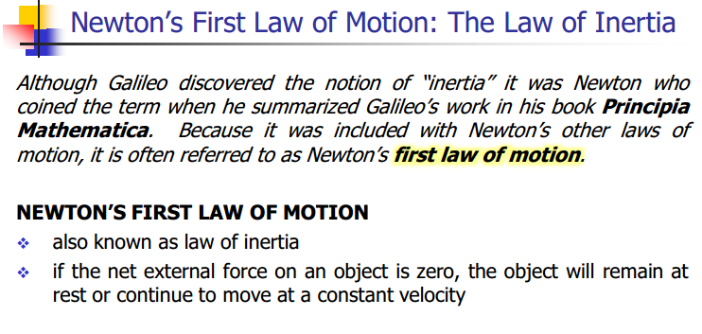

Slide 15
Newton’s 1st Law of Motion: Science of NFL Football (National Science Foundation)
https://www.youtube.com/watch?v=08BFCZJDn9w

Slide 22
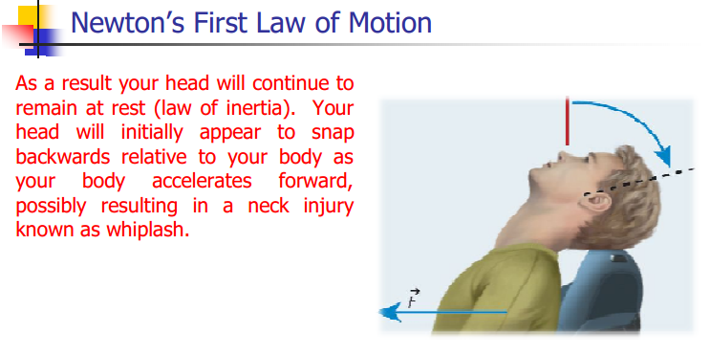

Slide 24
Newton’s Law of Inertia (Headrest and Airbags)
https://www.youtube.com/watch?v=8zsE3mpZ6Hw

