Slide 1
CH 3: Newton’s Laws of Motion
3.5 – Using Newton’s Laws

Slide 2
FBD’s

Slide 4
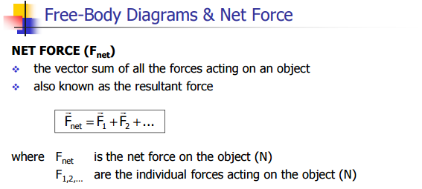

Slide 6
