Slide 1
CH 3: Newton’s Laws of Motion
3.1 Types of Forces

Slide 15
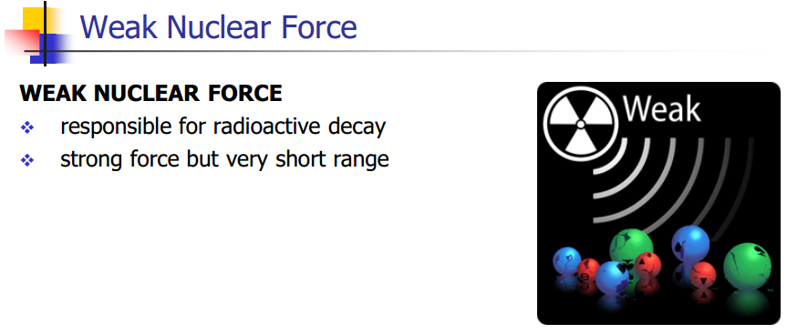

Slide 29
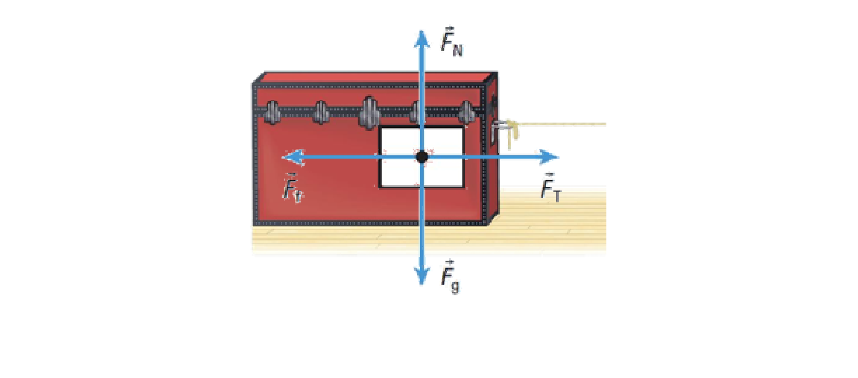

Slide 30
