Slide 1
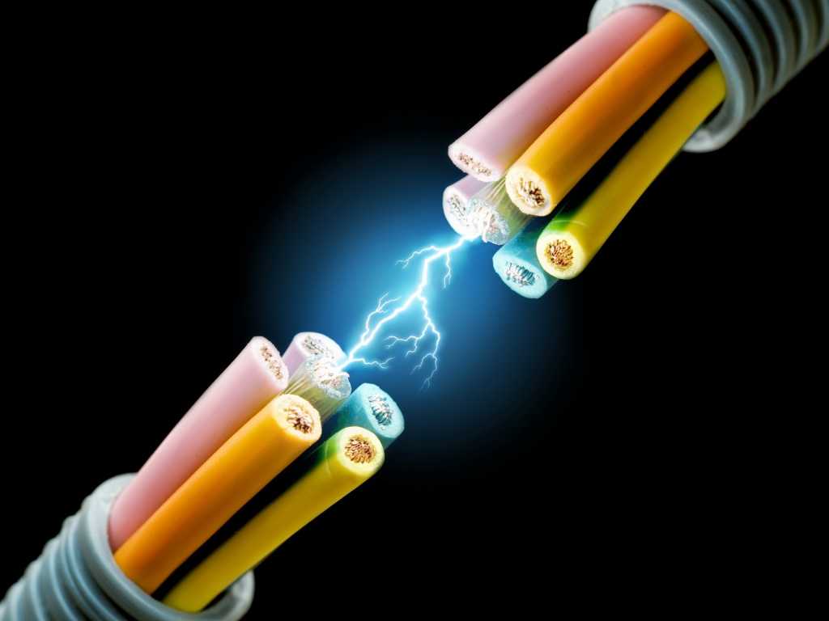
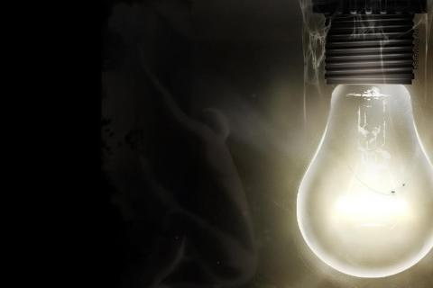
CH 11: Electricity and Its Production
11.5 – Electric Current

Slide 2
11.5 – Electric Current

Slide 12
Practice #1 pg. 517

Slide 13
Practice #2 pg. 517

Slide 20
Classwork & Homework

